Slide 1
Parallel & Distributed Processing
CSE-313

Slide 2
Parallel & Distributed Processing
Course Code: | CSE-313 | Credits: | 03
 |  | CIE Marks: | 90
Exam Hours: | 03 | SEE Marks: | 60
Course Learning Outcome (CLOs): After Completing this course successfully, the student will be able to…
CLO | Description
CLO 1 | Demonstrate an understanding of parallel and distributed computing concepts, including their necessity, advantages, and architectural design.
CLO 2 | Apply knowledge of Flynn’s taxonomy to classify parallel and distributed systems and their applications.
CLO 3 | Analyze and solve computational problems using parallel computing techniques to improve performance and efficiency.
CLO 4 | Develop programs using distributed computing models such as MapReduce for handling large-scale data processing.
CLO 5 | Design and evaluate distributed databases with a focus on fragmentation, replication, and allocation strategies.
CLO 6 | Assess the performance, fault tolerance, and scalability of distributed systems and suggest optimizations.
CLO 7 | Implement synchronization techniques to manage shared resources and ensure consistency in distributed environments.
CLO 8 | Explore the role of pipelining and instruction-level parallelism in improving the performance of parallel processors.

Slide 3
Summary of Course Content
Sl. | Course Content | HRs | CLOs
1 | Introduction to Parallel and Distributed Computing | 4 | CLO 1, CLO 2
2 | Flynn’s Taxonomy and Parallel Architectures | 3 | CLO 2, CLO 3
3 | Parallel Programming Models and Techniques | 6 | CLO 3, CLO 4
4 | Distributed Systems: Concepts and Architectures | 5 | CLO 1, CLO 5
5 | Synchronization and Resource Management | 4 | CLO 6, CLO 7
6 | Pipelining and Instruction-Level Parallelism | 3 | CLO 8
7 | MapReduce and Big Data Processing | 4 | CLO 4, CLO 6
8 | Distributed Databases: Fragmentation, Replication, and Allocation | 5 | CLO 5, CLO 6
9 | Fault Tolerance and Scalability in Distributed Systems | 4 | CLO 6
10 | Practical Applications and Case Studies | 2 | CLO 4, CLO 6, CLO 7
Recommended Books:
Parallel Programming: Techniques and Applications Using Networked Workstations and GPUs by Michael J. Quinn.
Distributed Systems: Principles and Paradigms by Andrew S. Tanenbaum and Maarten Van Steen.
Introduction to Parallel Computing by Ananth Grama, Anshul Gupta, George Karypis, and Vipin Kumar

Slide 4
Assessment Pattern
CIE- Continuous Internal Evaluation (90 Marks)
Bloom's Category Marks (out of 90) | Tests (45) | Assignments (15) | Quizzes (15) | Attendance (15)
Remember | 5 | 03
Understand | 5 | 04 | 05
Apply | 15 | 05 | 05
Analyze | 10
Evaluate | 5 | 03 | 05
Create | 5
SEE- Semester End Examination (60 Marks)
Bloom's Category | Test
Remember | 7
Understand | 7
Apply | 20
Analyze | 15
Evaluate | 6
Create | 5

Slide 5
Course Plan
Week No | Topics | Teaching Learning Strategy(s) | Assessment Strategy(s) | Alignment to CLO
1 | Introduction to Parallel and Distributed Computing | Lectures, Class Discussions | Quiz, Participation | CLO 1
2 | Flynn’s Taxonomy and Parallel Architectures | Lectures, Visual Diagrams | Assignment on Classification | CLO 2
3 | Parallel Programming Concepts and Models | Interactive Coding Sessions, Demonstrations | Lab Exercises | CLO 3
4 | Distributed System Architectures | Case Studies, Group Discussions | Midterm Quiz | CLO 1, CLO 5
5 | Synchronization Techniques in Parallel Systems | Hands-On Labs, Collaborative Problem Solving | Lab Assessment | CLO 7
6 | Pipelining and Instruction-Level Parallelism | Lectures, Simulations | Problem-Solving Assignment | CLO 8
7 | MapReduce Framework Basics | Tutorials, Hands-On Exercises | Programming Assignment | CLO 4
8 | Big Data and Distributed Processing Applications | Case Studies, Practical Labs | Lab Exercise | CLO 4, CLO 6
9 | Distributed Databases: Fragmentation and Allocation | Lectures, Class Exercises | Quiz on Fragmentation Concepts | CLO 5
10 | Data Replication and Fault Tolerance | Group Activities, Problem Solving | Case Study Report | CLO 6
11 | Performance Optimization in Parallel Systems | Interactive Problem Solving, Discussions | Midterm Exam | CLO 6, CLO 8
12 | Distributed Programming Techniques | Tutorials, Hands-On Practice | Programming Lab | CLO 4, CLO 5
13 | Resource Management in Distributed Systems | Lectures, Interactive Discussions | Quiz | CLO 6, CLO 7
14 | Scalability and Load Balancing in Distributed Systems | Case Studies, Simulations | Assignment on Scalability Strategies | CLO 6
15 | Advanced MapReduce and Fault Tolerance Mechanisms | Lab Sessions, Research Presentations | Project Report | CLO 4, CLO 6
16 | Applications of Parallel and Distributed Systems | Practical Applications, Guest Lectures | Final Project Presentation | CLO 4, CLO 6, CLO 7
17 | Course Review and Final Exam | Q&A, Practice Tests | Final Exam | All CLOs

Slide 6
Week 1
Slides 6-25

Slide 7
Parallel Processing

Slide 8
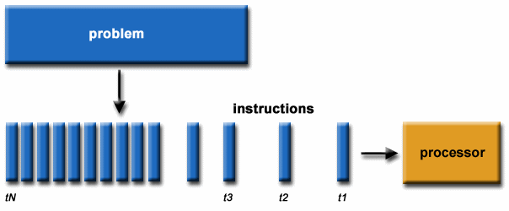
What is Serial Computing?
Traditionally, software has been written for serial computation:
A problem is broken into a discrete series of instructions
Instructions are executed sequentially one after another
Executed on a single processor
Only one instruction may execute at any moment in time

Slide 9

Example of Serial Computing

Slide 10
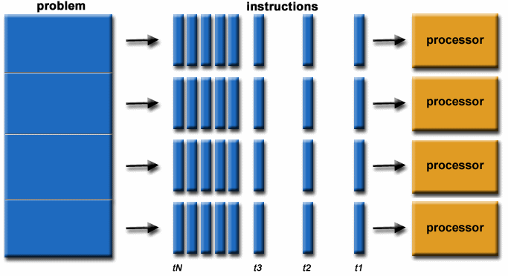
What is Parallel Computing?
In the simplest sense, parallel computing is the simultaneous use of multiple compute resources to solve a computational problem:

Slide 11
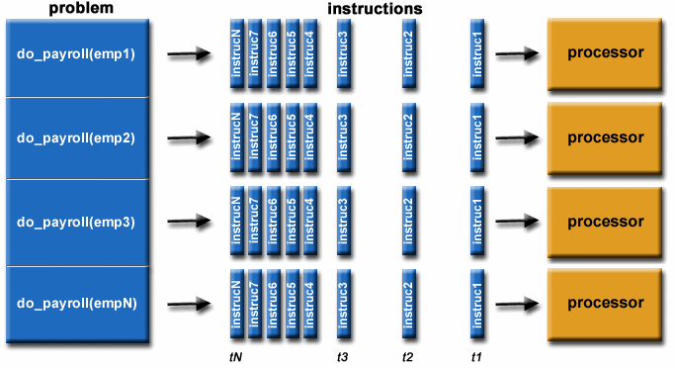
Parallel Computing
A problem is broken into discrete parts that can be solved concurrently
Each part is further broken down to a series of instructions
Instructions from each part execute simultaneously on different processors
An overall control/coordination mechanism is employed

Slide 12
Parallel Computing
The computational problem should be able to:
  Be broken apart into discrete pieces of work that can be solved simultaneously;
  Execute multiple program instructions at any moment in time;
  Be solved in less time with multiple compute resources than with a single compute resource.
The compute resources are typically:
  A single computer with multiple processors/cores
  An arbitrary number of such computers connected by a network

Slide 13
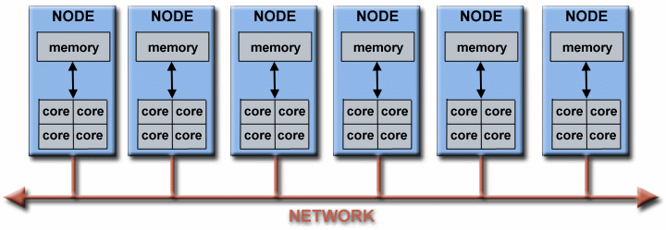
Parallel Computers:
Virtually all stand-alone computers today are parallel from a hardware perspective:
Multiple functional units (L1 cache, L2 cache, branch, decode, floating-point, graphics processing (GPU), etc.)
Multiple execution units/cores
Multiple hardware threads
Fig: Networks connect multiple stand-alone computers (nodes) to make larger parallel computer clusters

Slide 14
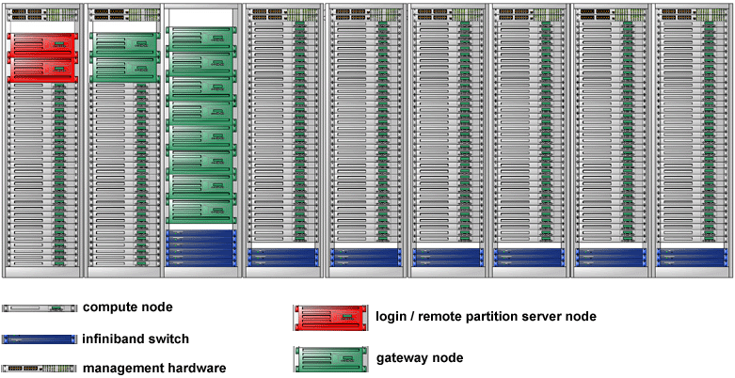
A typical LLNL parallel computer cluster
Each compute node is a multi-processor parallel computer in itself
Multiple compute nodes are networked together with an InfiniBand (IB) network
Special purpose nodes, also multi-processor, are used for other purposes

Slide 15

Why Use Parallel Computing?
SAVE TIME AND/OR MONEY :
In theory, throwing more resources at a task will shorten its time to completion, with potential cost savings.
Parallel computers can be built from cheap, commodity components.

Slide 16

SOLVE LARGER / MORE COMPLEX PROBLEMS:
Many problems are so large and/or complex that it is impractical or impossible to solve them on a single computer, especially given limited computer memory.
Example: Web search engines/databases processing millions of transactions every second

Slide 17

Why Use Parallel Computing?
PROVIDE CONCURRENCY:
A single compute resource can only do one thing at a time. Multiple compute resources can do many things simultaneously.
Example: Collaborative Networks provide a global venue where people from around the world can meet and conduct work "virtually".

Slide 18

TAKE ADVANTAGE OF NON-LOCAL RESOURCES:
Using compute resources on a wide area network, or even the Internet when local compute resources are scarce or insufficient.

Slide 19
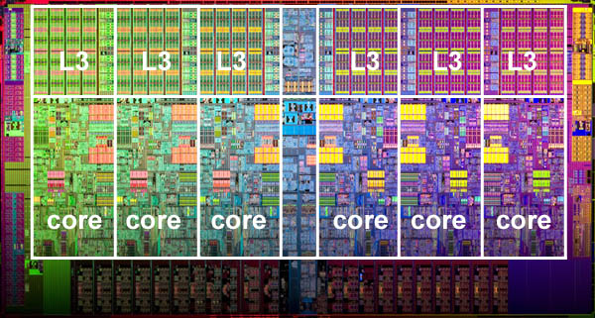
MAKE BETTER USE OF UNDERLYING PARALLEL HARDWARE:
Modern computers, even laptops, are parallel in architecture with multiple processors/cores.
Parallel software is specifically intended for parallel hardware with multiple cores, threads, etc.
In most cases, serial programs run on modern computers "waste" potential computing power.

Slide 20

Who is Using Parallel Computing?
Historically, parallel computing has been considered to be "the high end of computing", and has been used to model difficult problems in many areas of science and engineering:

Slide 21
Who is Using Parallel Computing?
Science and Engineering:
Atmosphere, Earth, Environment
Physics - applied, nuclear, particle, condensed matter, high pressure, fusion, photonics
Bioscience, Biotechnology, Genetics
Chemistry, Molecular Sciences
Defense, Geology
Mechanical Engineering - from prosthetics to spacecraft
Electrical Engineering, Circuit Design, Microelectronics
Computer Science, Mathematics

Slide 22
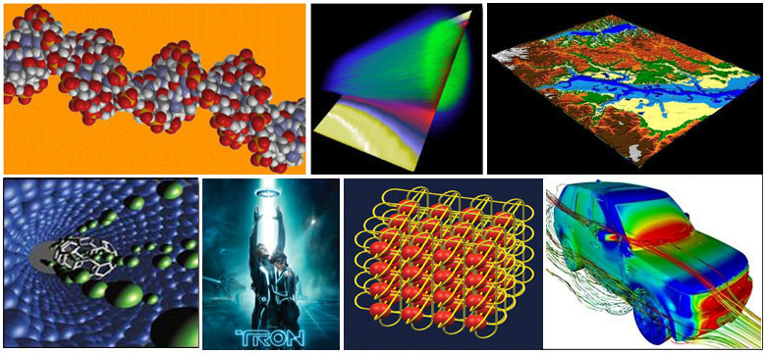
Who is Using Parallel Computing?
Industrial and Commercial:
Today, commercial applications provide an equal or greater driving force in the development of faster computers. These applications require the processing of large amounts of data in sophisticated ways. For example:

Slide 23
Who is Using Parallel Computing?
Industrial and Commercial:
"Big Data", databases, data mining
Oil exploration
Web search engines, web based business services
Medical imaging and diagnosis
Pharmaceutical design
Financial and economic modeling
Management of national and multi-national corporations
Advanced graphics and virtual reality, particularly in the entertainment industry
Networked video and multi-media technologies
Collaborative work environments

Slide 24

Open Questions
http://www.avego.com/blog/wp-content/uploads/2013/06/Your-Questions-Answered.jpg

Slide 25
THANK YOU

Slide 26
Week 2
Slides 26-37

Slide 27
Parallel Design and Programming

Slide 28
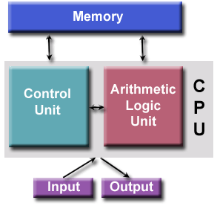
Von Neumann Architecture
Comprised of four main components:
  Memory
  Control Unit
  Arithmetic Logic Unit
  Input / Output
Read/write, random access memory is used to store both program instructions and data
  Program instructions are coded data which tell the computer to do something
  Data is simply information to be used by the program
Control unit fetches instructions/data from memory, decodes the instructions and then sequentially coordinates operations to accomplish the programmed task.
Aritmetic Unit performs basic arithmetic operations
Input/Output is the interface to the human operator
Parallel computers still follow this basic design, just multiplied in units. The basic, fundamental architecture remains the same.

Slide 29
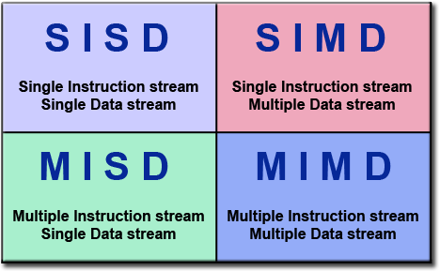
Flynn's Classical Taxonomy
Flynn's taxonomy distinguishes multi-processor computer architectures according to how they can be classified along the two independent dimensions of Instruction Stream and Data Stream. Each of these dimensions can have only one of two possible states: Single or Multiple.
The matrix below defines the 4 possible classifications according to Flynn:

Slide 30
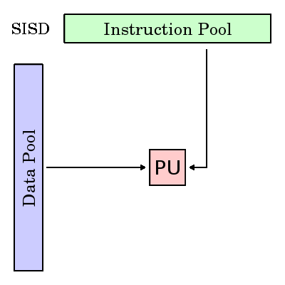
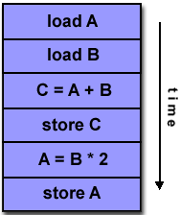
Single Instruction, Single Data (SISD):
A serial (non-parallel) computer
Single Instruction: Only one instruction stream is being acted on by the CPU during any one clock cycle
Single Data: Only one data stream is being used as input during any one clock cycle
Deterministic execution
This is the oldest type of computer
Examples: older generation mainframes, minicomputers, workstations and single processor/core PCs.

Slide 31
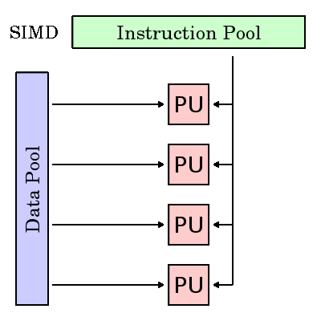
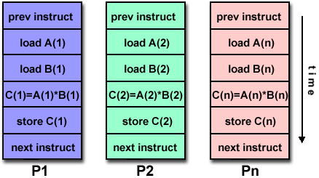
Single Instruction, Multiple Data (SIMD):
A type of parallel computer
Single Instruction: All processing units execute the same instruction at any given clock cycle
Multiple Data: Each processing unit can operate on a different data element
Best suited for specialized problems characterized by a high degree of regularity, such as graphics/image processing.
Synchronous (lockstep) and deterministic execution
Two varieties: Processor Arrays and Vector Pipelines
  Most modern computers, particularly those with graphics processor units (GPUs) employ SIMD instructions and execution units.

Slide 32
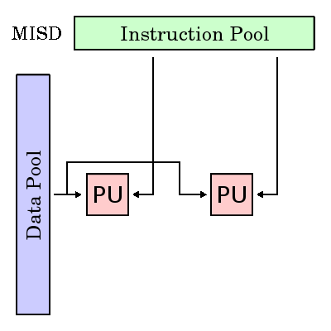
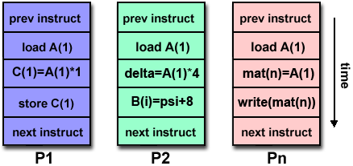
Multiple Instruction, Single Data (MISD)
A type of parallel computer
Multiple Instruction: Each processing unit operates on the data independently via separate instruction streams.
Single Data: A single data stream is fed into multiple processing units.
Few (if any) actual examples of this class of parallel computer have ever existed.
Some conceivable uses might be:
  multiple cryptography algorithms attempting to crack a single coded message.

Slide 33
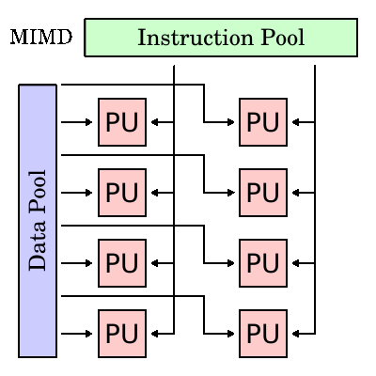
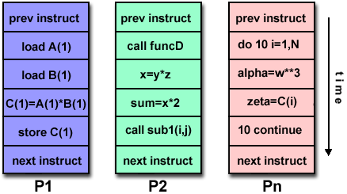
Multiple Instruction, Multiple Data (MIMD):
A type of parallel computer
Multiple Instruction: Every processor may be executing a different instruction stream
Multiple Data: Every processor may be working with a different data stream
Execution can be synchronous or asynchronous, deterministic or non-deterministic
Currently, the most common type of parallel computer - most modern supercomputers fall into this category.
Examples: most current supercomputers, networked parallel computer clusters and "grids", multi-processor SMP computers, multi-core PCs.
Note: many MIMD architectures also include SIMD execution sub-components

Slide 34
Some General Parallel Terminology
Supercomputing / High Performance Computing (HPC) :Using the world's fastest and largest computers to solve large problems.
Node : A standalone "computer in a box". Usually comprised of multiple CPUs/processors/cores, memory, network interfaces, etc. Nodes are networked together to comprise a supercomputer.
CPU / Socket / Processor / Core :
  CPU (Central Processing Unit) was a singular execution component for a computer.
  Multiple CPUs were incorporated into a node.
  Individual CPUs were subdivided into multiple "cores", each being a unique execution unit.
  CPUs with multiple cores are sometimes called "sockets" - vendor dependent. The result is a node with multiple CPUs, each containing multiple cores.

Slide 35
Task : A logically discrete section of computational work. A task is typically a program or program-like set of instructions that is executed by a processor. A parallel program consists of multiple tasks running on multiple processors.
Pipelining : Breaking a task into steps performed by different processor units, with inputs streaming through, much like an assembly line; a type of parallel computing.
Shared Memory : From a strictly hardware point of view, describes a computer architecture where all processors have direct (usually bus based) access to common physical memory. In a programming sense, it describes a model where parallel tasks all have the same "picture" of memory and can directly address and access the same logical memory locations regardless of where the physical memory actually exists.
Distributed Memory : In hardware, refers to network based memory access for physical memory that is not common. As a programming model, tasks can only logically "see" local machine memory and must use communications to access memory on other machines where other tasks are executing
Symmetric Multi-Processor (SMP) : Shared memory hardware architecture where multiple processors share a single address space and have equal access to all resources.

Slide 36
Synchronization : The coordination of parallel tasks in real time, very often associated with communications. Often implemented by establishing a synchronization point within an application where a task may not proceed further until another task(s) reaches the same or logically equivalent point.
Massively Parallel : Refers to the hardware that comprises a given parallel system - having many processing elements. The meaning of "many" keeps increasing, but currently, the largest parallel computers are comprised of processing elements numbering in the hundreds of thousands to millions.
Embarrassingly Parallel : Solving many similar, but independent tasks simultaneously; little to no need for coordination between the tasks.
Scalability : Refers to a parallel system's (hardware and/or software) ability to demonstrate a proportionate increase in parallel speedup with the addition of more resources. Factors that contribute to scalability include:
  Hardware - particularly memory-cpu bandwidths and network communication properties
  Application algorithm
  Parallel overhead related
  Characteristics of your specific application

Slide 37
Costs of Parallel Programming
Amdahl's Law states that potential program speedup is defined by the fraction of code (P) that can be parallelized:
If none of the code can be parallelized, P = 0 and the speedup = 1 (no speedup).
If all of the code is parallelized, P = 1 and the speedup is infinite (in theory).
If 50% of the code can be parallelized, maximum speedup = 2, meaning the code will run twice as fast.
Introducing the number of processors performing the parallel fraction of work, the relationship can be modeled by:
1 speedup = -------- 1 - P
1 speedup = -------------- P --- + S N
where P = parallel fraction, N = number of processors and S = serial fraction.

Slide 38
Week 3
Slides 38-50

Slide 39
Parallel Computer Model

Slide 40
Outline
Multivector Computer
  Description
  Advantages
  Architecture
    Vector supercomputers
    Memory-to-memory
    Register-to-register
SIMD Computer

Slide 41
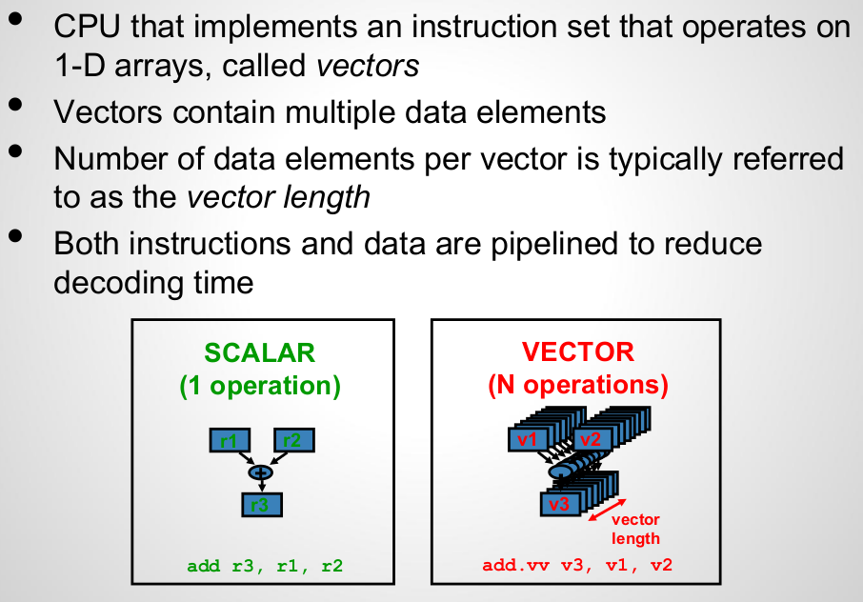
Description of Vector Processors

Slide 42
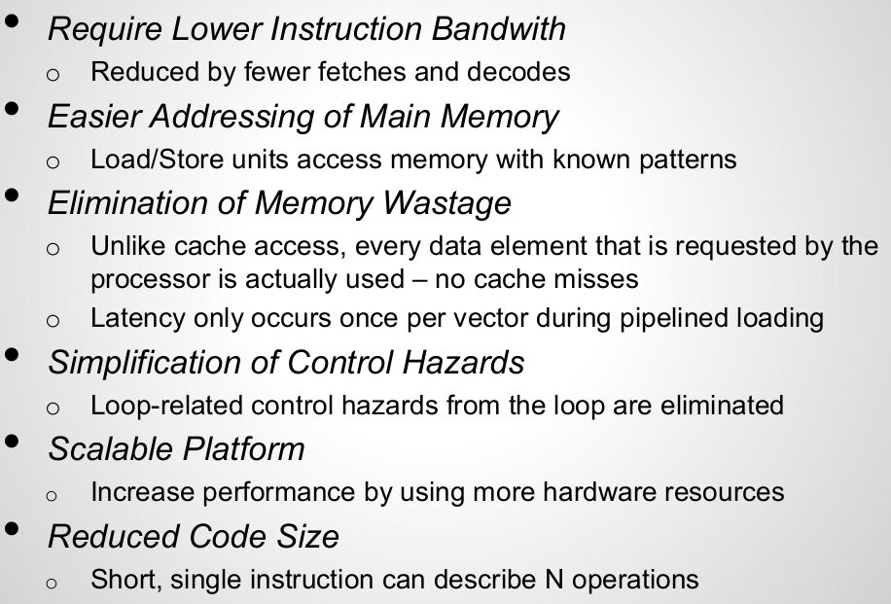
Advantages of Vector Processors

Slide 43
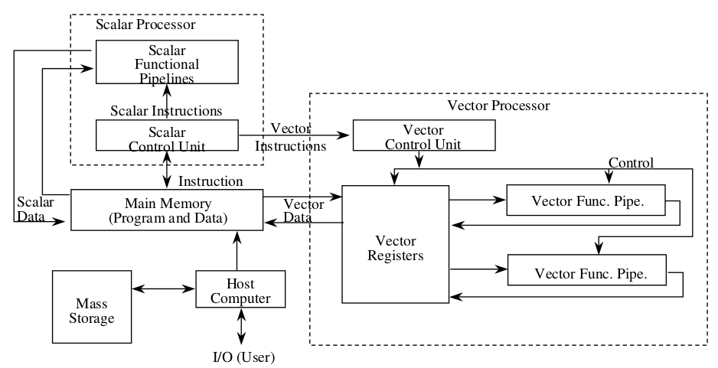
Architecture of a Vector Supercomputers

Slide 44
Architecture of a Vector Supercomputers(cont)
Often build on top of a scalar processor
Vector processor is attached to the scalar processor as an optional feature
Program and data are first loaded into the main memory through a host computer
All instructions are first decoded by the scalar control unit. If the decoded instruction is a scalar operation or a program control then directly executed by the scalar processor using the scalar functional pipelines
If the instruction is decoded as a vector operation then sent to the vector control unit(VCU). VCU supervise the flow of vector data between the main memory and vector functional pipelines
Two pipeline vector supercomputer models
  Register-to-register
  Memory-to-memory

Slide 45
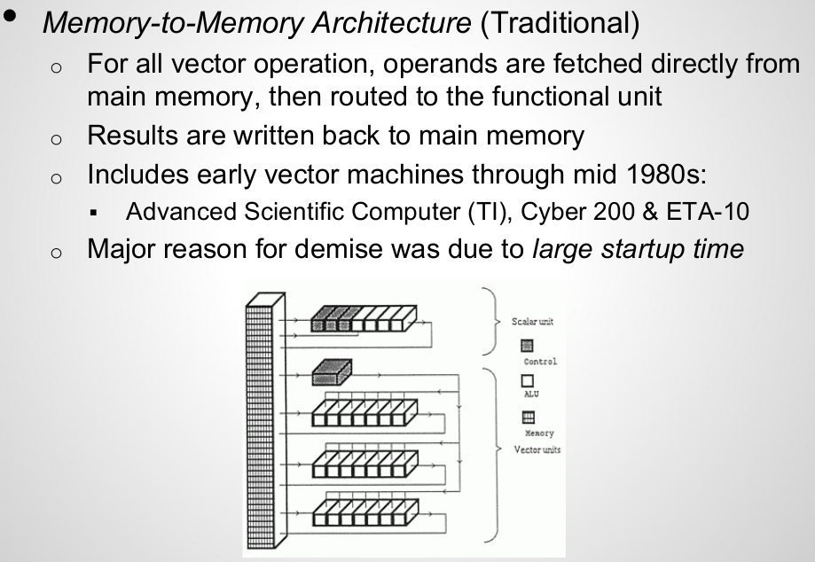
Vector Processor Architectures

Slide 46
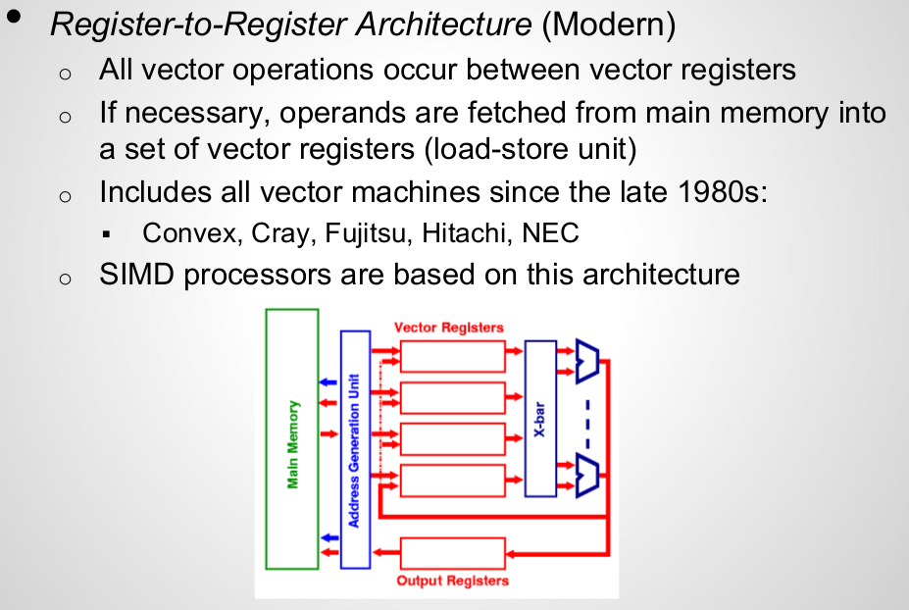
Vector Processor Architectures (cont)

Slide 47
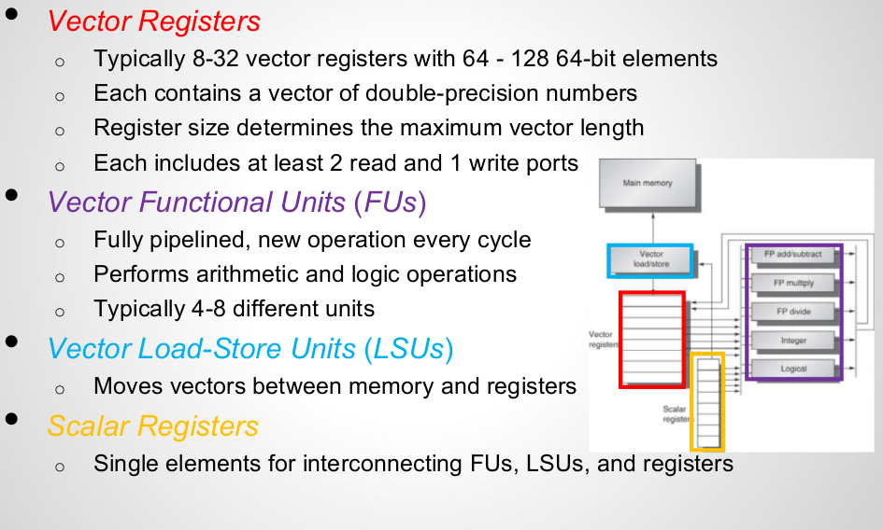
Components of Vector Processors

Slide 48
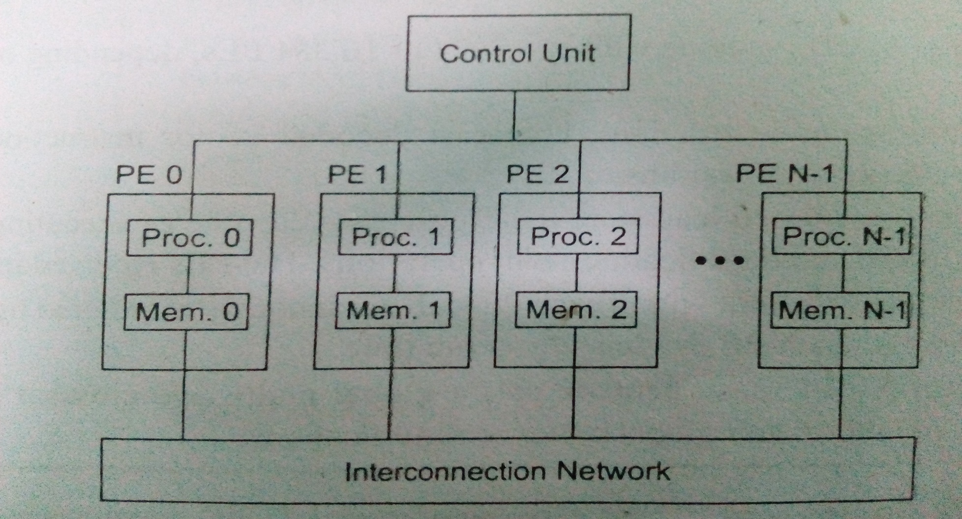
SIMD Supercomputers
Fig. : Operational Model of SIMD computers

Slide 49
SIMD Machine Model
An operational model of an SIMD computer is specified by a 5-tuple: M = (N, C, I, M, R) where
  N is the number of processing elements (PEs)
  C is the set of instructions directly executed by the CU, including scalar and program flow control instructions
  I is the set of instructions broadcast by the CU to all PEs for parallel execution
  M is the set of masking schemes, where each mask partitions the set of PEs into enabled and disabled subsets
  R is the set of data-routing functions, specifying various patterns to be setup in the interconnection network for inter-PE communication

Slide 50
Questions?
THANK YOU

Slide 51
Week 4
Slides 51-65

Slide 52
Program and Network Properties
Conditions of parallelism
Program partitioning and scheduling
Program flow mechanisms
System interconnect architectures

Slide 53
Conditions of Parallelism
The exploitation of parallelism in computing requires understanding the basic theory associated with it. Progress is needed in several areas:
  computation models for parallel computing
  interprocessor communication in parallel architectures
  integration of parallel systems into general environments

Slide 54
Data dependences
The ordering relationship between statements is indicated by the data dependence.
Flow dependence
Anti dependence
Output dependence
I/O dependence
Unknown dependence

Slide 55
Data Dependence - 1
Flow dependence: S1 precedes S2, and at least one output of S1 is input to S2.
Antidependence: S1 precedes S2, and the output of S2 overlaps the input to S1.
Output dependence: S1 and S2 write to the same output variable.
I/O dependence: two I/O statements (read/write) reference the same variable, and/or the same file.

Slide 56
Data Dependence - 2
Unknown dependence:
  The subscript of a variable is itself subscripted.
  The subscript does not contain the loop index variable.
  A variable appears more than once with subscripts having different coefficients of the loop variable (that is, different functions of the loop variable).
  The subscript is nonlinear in the loop index variable.
Parallel execution of program segments which do not have total data independence can produce non-deterministic results.

Slide 57
Data dependence example
S1: Load R1, A
S2: Add R2, R1
S3: Move R1, R3
S4: Store B, R1
S1
S2
S4
S3

Slide 58
I/O dependence example
S1: Read (4), A(I)
S2: Rewind (4)
S3: Write (4), B(I)
S4: Rewind (4)
S1
I/O
S3

Slide 59
Control dependence
The order of execution of statements cannot be determined before run time
  Conditional branches
  Successive operations of a looping procedure

Slide 60
Control dependence examples
Do 20 I = 1, N
A(I) = C(I)
IF(A(I) .LT. 0) A(I)=1
20 Continue
Do 10 I = 1, N
IF(A(I-1) .EQ. 0) A(I)=0
10 Continue

Slide 61
Resource dependence
Concerned with the conflicts in using shared resources
  Integer units
  Floating-point units
  Registers
  Memory areas
  ALU
  Workplace storage

Slide 62
Bernstein’s conditions
Set of conditions for two processes to execute in parallel
  I₁ ∩ O₂ = Ø
  I₂ ∩ O₁ = Ø
  O₁ ∩ O₂ = Ø

Slide 63
Bernstein’s Conditions - 2
In terms of data dependencies, Bernstein’s conditions imply that two processes can execute in parallel if they are flow-independent, anti-independent, and output-independent.
The parallelism relation || is commutative (P_{i} || P_{j} implies P_{j} || P_{i} ), but not transitive (P_{i} || P_{j} and P_{j} || P_{k} does not imply P_{i} || P_{k} ) . Therefore, || is not an equivalence relation.
Intersection of the input sets is allowed.

Slide 64
Utilizing Bernstein’s conditions
P₁ : C = D x E
P₂ : M = G + C
P₃ : A = B + C
P₄ : C = L + M
P₅ : F = G / E
P1
P2
P4
P3
P5

Slide 65
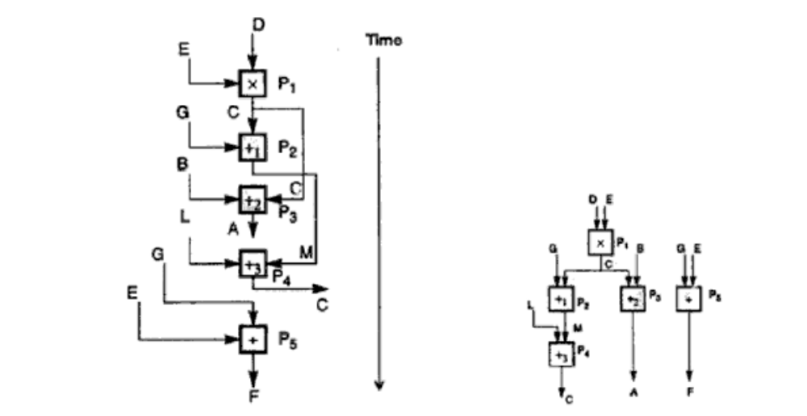
Utilizing Bernstein’s conditions

Slide 66
Week 5
Slides 66-77

Slide 67
Hardware parallelism
A function of cost and performance tradeoffs
Displays the resource utilization patterns of simultaneously executable operations
Denote the number of instruction issues per machine cycle: k-issue processor
A multiprocessor system with n k-issue processors should be able to handle a maximum number of nk threads of instructions simultaneously

Slide 68
Software parallelism
Defined by the control and data dependence of programs
A function of algorithm, programming style, and compiler organization
The program flow graph displays the patterns of simultaneously executable operations

Slide 69
Mismatch between software and hardware parallelism - 1
Cycle 1
L₁
L₂
L₃
L₄
Maximum software parallelism (L=load, X/+/- = arithmetic)
8 instructions(4 loads and 4 arithmetic operations )
Parallelism varies from 4 to 2 in three cycles
Cycle 2
X₁
X₂
Cycle 3
+
-
A
B
Fig. : Software parallelism

Slide 70
Mismatch between software and hardware parallelism - 2
L₁
Cycle 1
Same problem, but considering the parallelism on a two-issue superscalar processor.
L₂
Cycle 2
X₁
L₃
Cycle 3
L₄
Cycle 4
X₂
Cycle 5
+
Cycle 6
-
Cycle 7
A
B

Slide 71
Mismatch between software and hardware parallelism - 3
L₁
L₃
Cycle 1
L₂
L₄
Cycle 2
Same problem, with two single-issue processors
X₁
X₂
Cycle 3
S₁
S₂
Cycle 4
L₅
L₆
Cycle 5
= inserted for synchronization
+
-
Cycle 6
Fig. : Dual processor execution
A
B

Slide 72
Software parallelism
Control parallelism – allows two or more operations to be performed concurrently
  Pipelining, multiple functional units
Data parallelism – almost the same operation is performed over many data elements by many processors concurrently
  Code is easier to write and debug

Slide 73
Types of Software Parallelism
Control Parallelism – two or more operations can be performed simultaneously. This can be detected by a compiler, or a programmer can explicitly indicate control parallelism by using special language constructs or dividing a program into multiple processes.
Data parallelism – multiple data elements have the same operations applied to them at the same time. This offers the highest potential for concurrency (in SIMD and MIMD modes). Synchronization in SIMD machines handled by hardware.

Slide 74
Solving the Mismatch Problems
Develop compilation support
Redesign hardware for more efficient exploitation by compilers
Use large register files and sustained instruction pipelining.
Have the compiler fill the branch and load delay slots in code generated for RISC processors.

Slide 75
The Role of Compilers
Compilers used to exploit hardware features to improve performance.
Interaction between compiler and architecture design is a necessity in modern computer development.
It is not necessarily the case that more software parallelism will improve performance in conventional scalar processors.
The hardware and compiler should be designed at the same time.

Slide 76
Program Partitioning & Scheduling
The size of the parts or pieces of a program that can be considered for parallel execution can vary.
The sizes are roughly classified using the term “granule size,” or simply “granularity.”
The simplest measure, for example, is the number of instructions in a program part.
Grain sizes are usually described as fine, medium or coarse, depending on the level of parallelism involved.

Slide 77
Latency
Latency is the time required for communication between different subsystems in a computer.
Memory latency, for example, is the time required by a processor to access memory.
Synchronization latency is the time required for two processes to synchronize their execution.
Computational granularity and communication latency are closely related.

Slide 78
Week 6
Slides 78-98

Slide 79
Levels of Parallelism
}
Jobs or programs
Increasing communication demand and scheduling overhead
Higher degree of parallelism
Coarse grain
Subprograms, job steps or
related parts of a program
}
Medium grain
Procedures, subroutines,
tasks, or coroutines
}
Non-recursive loops
or unfolded iterations
Fine grain
Instructions
or statements

Slide 80
Instruction Level Parallelism
This fine-grained, or smallest granularity level typically involves less than 20 instructions per grain. The number of candidates for parallel execution varies from 2 to thousands, with about five instructions or statements (on the average) being the average level of parallelism.
Advantages:
  There are usually many candidates for parallel execution
  Compilers can usually do a reasonable job of finding this parallelism

Slide 81
Loop-level Parallelism
Typical loop has less than 500 instructions.
If a loop operation is independent between iterations, it can be handled by a pipeline, or by a SIMD machine.
Most optimized program construct to execute on a parallel or vector machine
Some loops (e.g. recursive) are difficult to handle.
Loop-level parallelism is still considered fine grain computation.

Slide 82
Procedure-level Parallelism
Medium-sized grain; usually less than 2000 instructions.
Detection of parallelism is more difficult than with smaller grains; interprocedural dependence analysis is difficult and history-sensitive.
Communication requirement less than instruction-level
SPMD (single procedure multiple data) is a special case
Multitasking belongs to this level.

Slide 83
Subprogram-level Parallelism
Job step level; grain typically has thousands of instructions; medium- or coarse-grain level.
Job steps can overlap across different jobs.
Multiprograming conducted at this level
No compilers available to exploit medium- or coarse-grain parallelism at present.

Slide 84
Job or Program-Level Parallelism
Corresponds to execution of essentially independent jobs or programs on a parallel computer.
This is practical for a machine with a small number of powerful processors, but impractical for a machine with a large number of simple processors (since each processor would take too long to process a single job).

Slide 85
Communication Latency
Balancing granularity and latency can yield better performance.
Various latencies attributed to machine architecture, technology, and communication patterns used.
Latency imposes a limiting factor on machine scalability. Ex. Memory latency increases as memory capacity increases, limiting the amount of memory that can be used with a given tolerance for communication latency.

Slide 86
Interprocessor Communication Latency
Needs to be minimized by system designer
Affected by signal delays and communication patterns
Ex. n communicating tasks may require n (n - 1)/2 communication links, and the complexity grows quadratically, effectively limiting the number of processors in the system.

Slide 87
Grain Packing and Scheduling
Two questions:
  How can I partition a program into parallel “pieces” to yield the shortest execution time?
  What is the optimal size of parallel grains?
There is an obvious tradeoff between the time spent scheduling and synchronizing parallel grains and the speedup obtained by parallel execution.
Solution is both problem-dependent and machine-dependent.
Goal is to produce a short schedule for fast execution of subdivided program modules.
One approach to the problem is called “grain packing”

Slide 88
Program Graphs and Packing
A program graph is similar to a dependence graph
  Nodes = { (n,s) }, where n = node name, s = size (larger s = larger grain size).
  Edges = { (v,d) }, where v = variable being “communicated,” and d = communication delay.
Packing two (or more) nodes produces a node with a larger grain size and possibly more edges to other nodes.
Packing is done to eliminate unnecessary communication delays or reduce overall scheduling overhead.

Slide 89
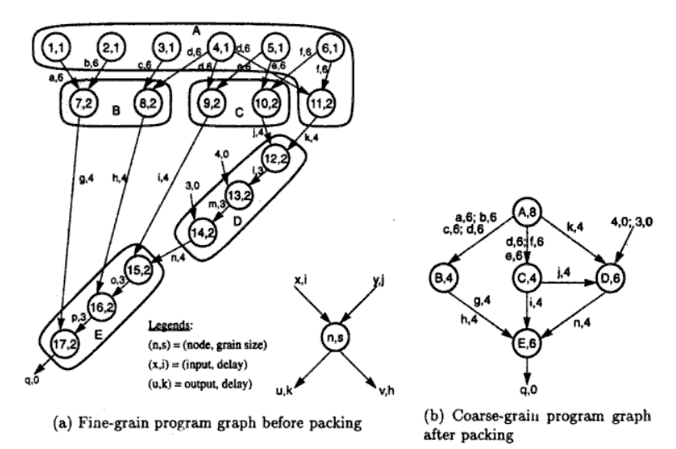
EENG-630 - Chapter 2

Slide 90
Scheduling
A schedule is a mapping of nodes to processors and start times such that communication delay requirements are observed, and no two nodes are executing on the same processor at the same time.
Some general scheduling goals
  Schedule all fine-grain activities in a node to the same processor to minimize communication delays.
  Select grain sizes for packing to achieve better schedules for a particular parallel machine.

Slide 91
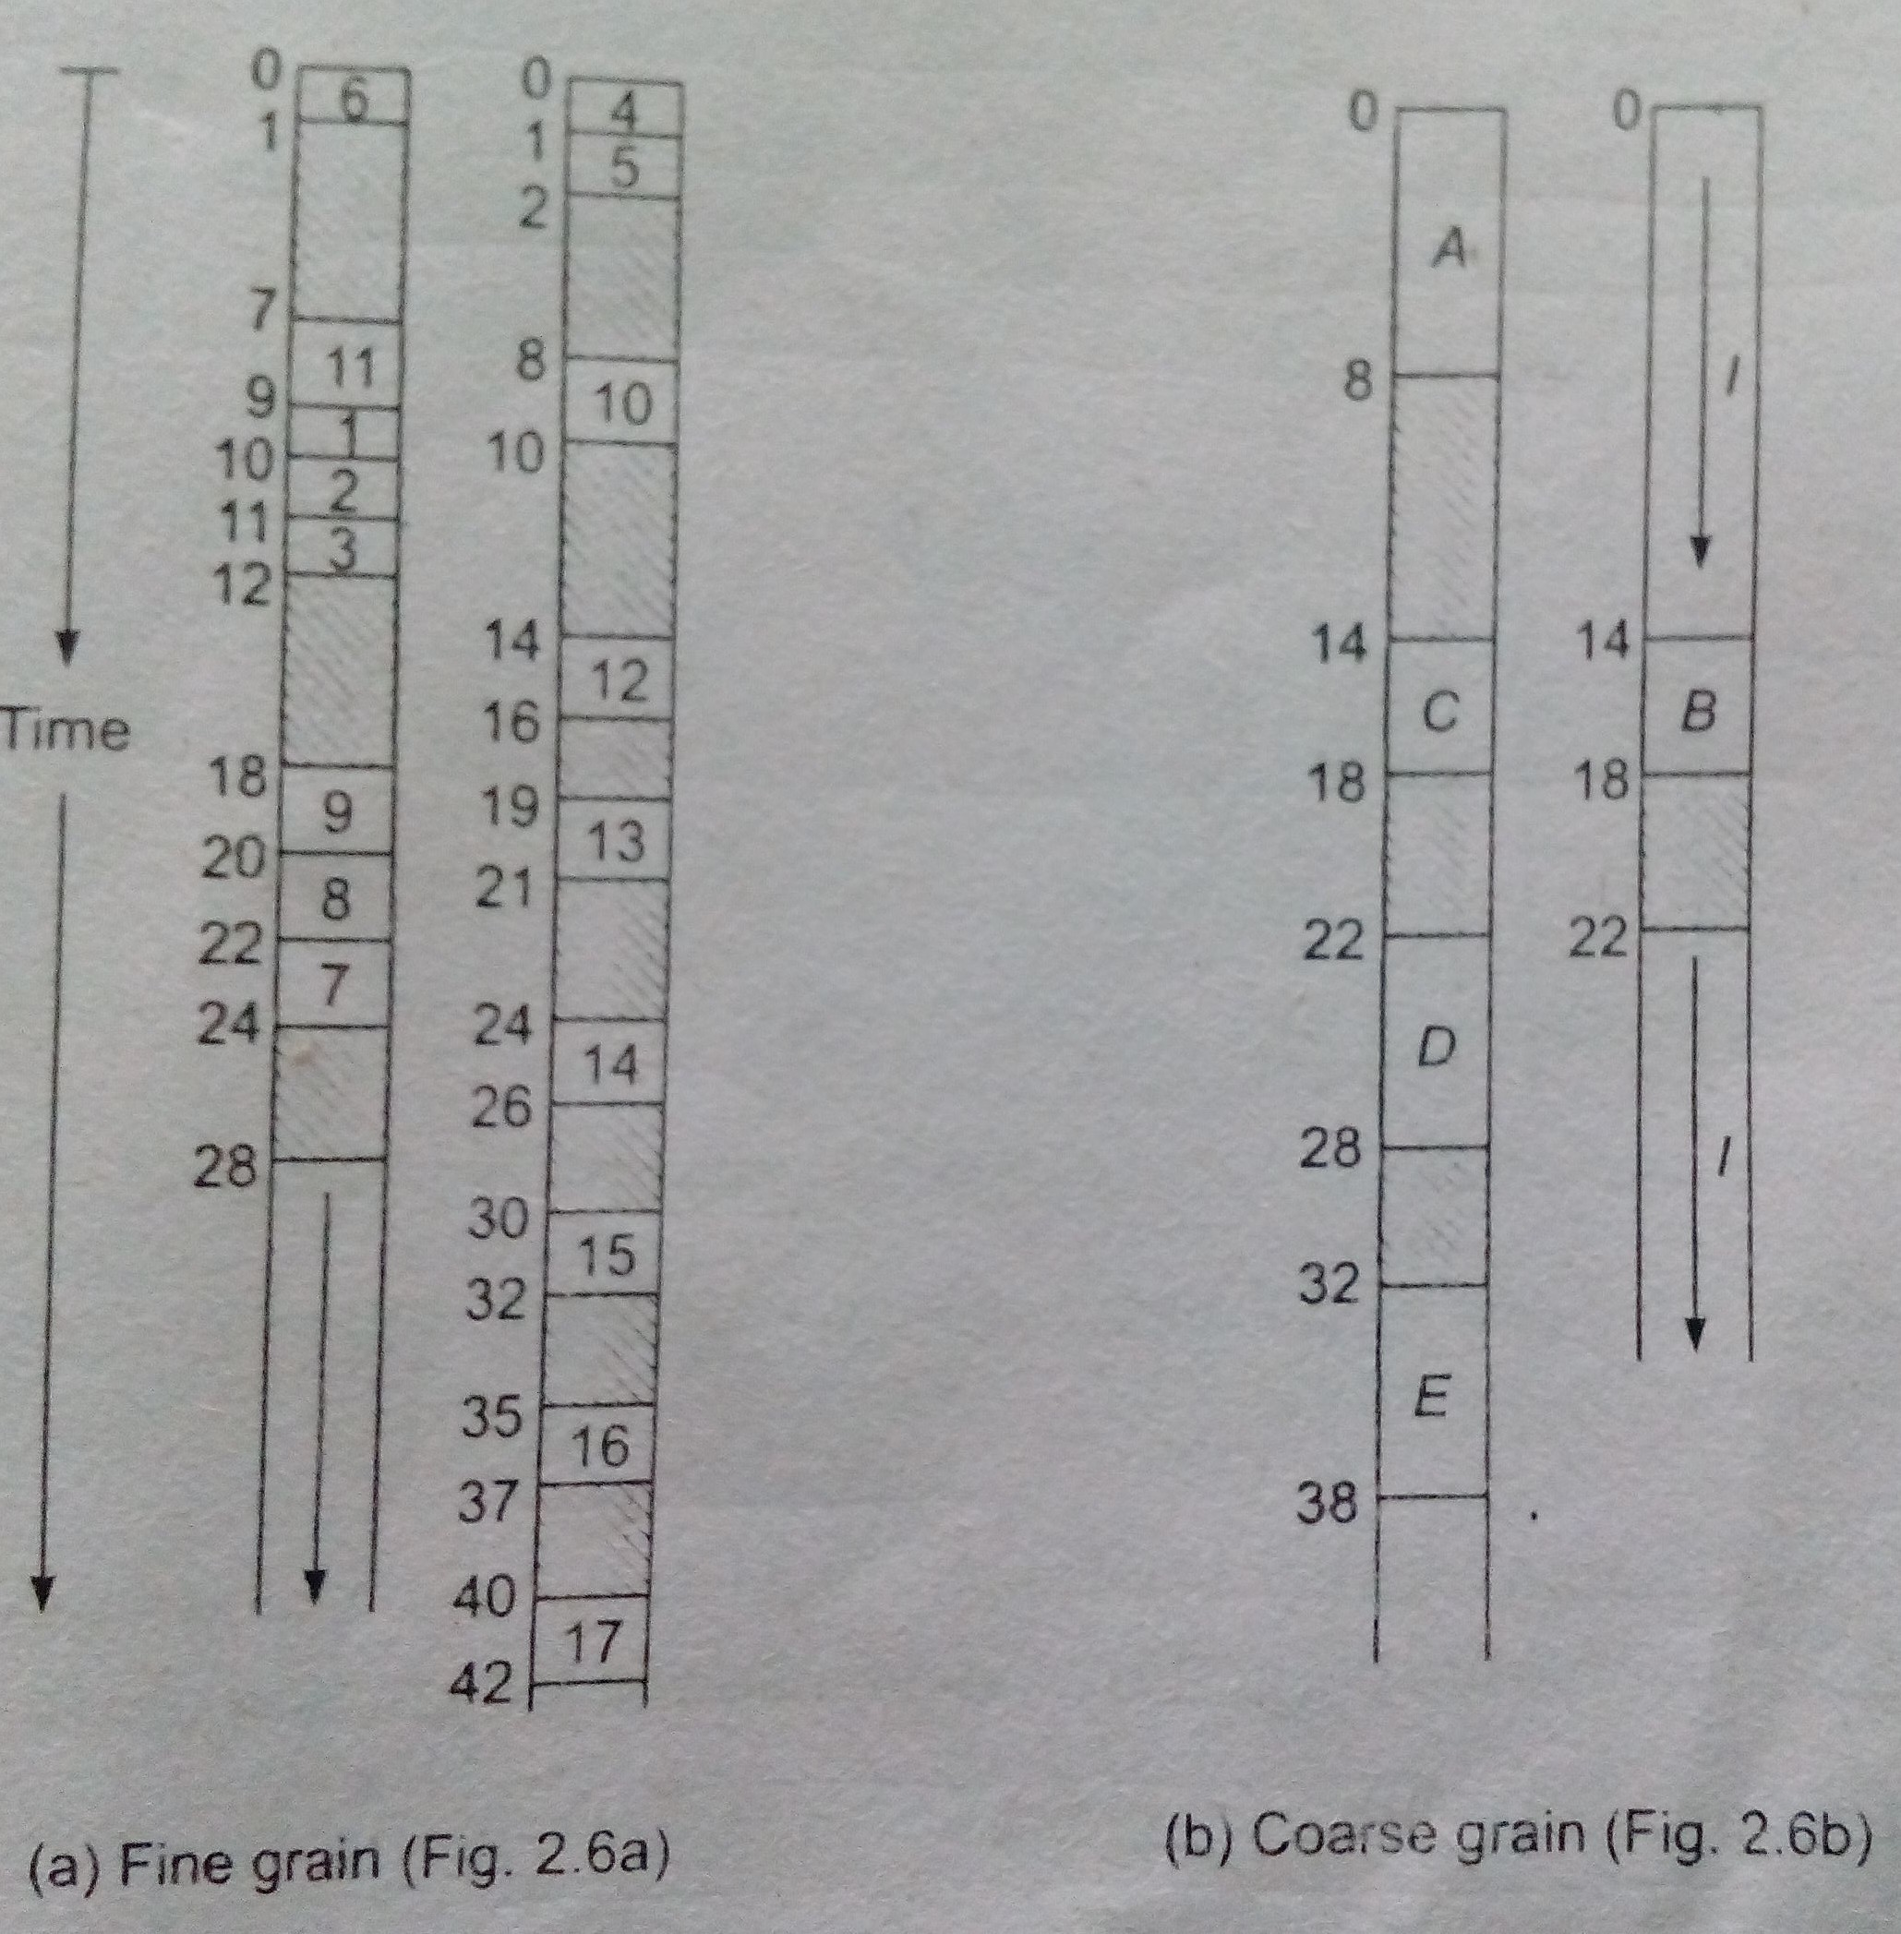
Scheduling (Cont)

Slide 92
Static multiprocessor scheduling
Grain packing may not be optimal
Dynamic multiprocessor scheduling is an NP-hard problem
Node duplication is a static scheme for multiprocessor scheduling

Slide 93
Node duplication
Duplicate some nodes to eliminate idle time and reduce communication delays
Grain packing and node duplication are often used jointly to determine the best grain size and corresponding schedule

Slide 94
Schedule without node duplication
P1
P2
P1
P2
A,4
4
A
I
4
a,1
a,8
6
B
B,1
C,1
I
c,1
13
12
c,8
C
14
b,1
E
D,2
E,2
16
21
20
D
23
d,4
e,4
27

Slide 95
Schedule with node duplication
P1
P2
P1
P2
A,4
A’,4
4
A
A
a,1
a,1
4
a,1
6
B
C
6
B,1
C,1
C
C’,1
7
c,1
E
b,1
c,1
D
9
D,2
E,2
10
13
14

Slide 96
Grain determination and scheduling optimization
Step 1: Construct a fine-grain program graph
Step 2: Schedule the fine-grain computation
Step 3: Grain packing to produce coarse grains
Step 4: Generate a parallel schedule based on the packed graph

Slide 97
System Interconnect Architectures
Direct networks for static connections
Indirect networks for dynamic connections
Networks are used for
  internal connections in a centralized system among
    processors
    memory modules
    I/O disk arrays
  distributed networking of multicomputer nodes

Slide 98
Goals and Analysis
The goals of an interconnection network are to provide
  low-latency
  high data transfer rate
  wide communication bandwidth
Analysis includes
  latency
  bisection bandwidth
  data-routing functions
  scalability of parallel architecture

Slide 99
Week 7
Slides 99-107

Slide 100
Network Properties and Routing
Static networks: point-to-point direct connections that will not change during program execution
Dynamic networks:
  switched channels dynamically configured to match user program communication demands
  include buses, crossbar switches, and multistage networks
Both network types also used for inter-PE data routing in SIMD computers

Slide 101
Network Parameters
Network size: The number of nodes (links or channels) in the graph used to represent the network
Node Degree d: The number of edges incident to a node. In the case of unidirectional channels, the number of channels into a node is the in degree and that out of a node is the out degree. Then the node degree is the sum of the two.
Network Diameter D: The maximum shortest path between any two nodes

Slide 102
Network Parameters (cont.)
Bisection Width:
  Channel bisection width b: The minimum number of edges (channels) along the cut that divides the network in two equal halves
  Each channel has w bit wires
  Wire bisection width: B=b*w; B is the wiring density of the network. It provides a good indicator of the max communication bandwidth along the bisection of the network

Slide 103
Terminology - 1
Network usually represented by a graph with a finite number of nodes linked by directed or undirected edges.
Number of nodes in graph = network size .
Number of edges (links or channels) incident on a node = node degree d (also note in and out degrees when edges are directed). Node degree reflects number of I/O ports associated with a node, and should ideally be small and constant.
Diameter D of a network is the maximum shortest path between any two nodes, measured by the number of links traversed; this should be as small as possible (from a communication point of view).

Slide 104
Terminology - 2
Channel bisection width b = minimum number of edges cut to split a network into two parts each having the same number of nodes. Since each channel has w bit wires, the wire bisection width B = bw. Bisection width provides good indication of maximum communication bandwidth along the bisection of a network, and all other cross sections should be bounded by the bisection width.
Wire (or channel) length = length (e.g. weight) of edges between nodes.
Network is symmetric if the topology is the same looking from any node; these are easier to implement or to program.
Other useful characterizing properties: homogeneous nodes? buffered channels? nodes are switches?

Slide 105
Data Routing Functions
Data-routing network used for inter-PE data exchange. This network can be static (i.e: hypercube) or dynamic (i.e: multistage network)
Commonly data-routing functions includes:
Shifting
Rotating
Permutation (one to one)
Broadcast (one to all)
Multicast (many to many)
Personalized broadcast (one to many)
Shuffle
Exchange
Etc.

Slide 106
Hypercube Routing Functions
If the vertices of a n-dimensional cube are labeled with n-bit numbers so that only one bit differs between each pair of adjacent vertices, then n routing functions are defined by the bits in the node (vertex) address.
For example, with a 3-dimensional cube, we can easily identify routing functions that exchange data between nodes with addresses that differ in the least significant, most significant, or middle bit.
Figure: 2.15

Slide 107
Factors Affecting Network Performance
Functionality – how the network supports data routing, interrupt handling, synchronization, request/message combining, and coherence
Network latency – worst-case time for a unit message to be transferred
Bandwidth – maximum data rate
Hardware complexity – implementation costs for wire, logic, switches, connectors, etc.
Scalability – how easily does the scheme adapt to an increasing number of processors, memories, etc.?

Slide 108
Week 8
Slides 108-127

Slide 109
Static Networks
Linear Array
Ring and Chordal Ring
Barrel Shifter
Tree and Star
Fat Tree
Mesh and Torus

Slide 110
Static Networks – Linear Array
N nodes connected by n-1 links (not a bus); segments between different pairs of nodes can be used in parallel.
Internal nodes have degree 2; end nodes have degree 1.
Diameter = n-1
Bisection = 1
For small n, this is economical, but for large n, it is obviously inappropriate.

Slide 111
Static Networks – Ring, Chordal Ring
Like a linear array, but the two end nodes are connected by an n ^{th} link; the ring can be uni- or bi-directional. Diameter is ⎣n/2⎦ for a bidirectional ring, or n for a unidirectional ring.
By adding additional links (e.g. “chords” in a circle), the node degree is increased, and we obtain a chordal ring. This reduces the network diameter.
In the limit, we obtain a fully-connected network, with a node degree of n -1 and a diameter of 1.

Slide 112
Static Networks – Barrel Shifter
Like a ring, but with additional links between all pairs of nodes that have a distance equal to a power of 2.
With a network of size N = 2^{n}, each node has degree d = 2n -1, and the network has diameter D = n /2.
Barrel shifter connectivity is greater than any chordal ring of lower node degree.
Barrel shifter much less complex than fully-interconnected network.

Slide 113
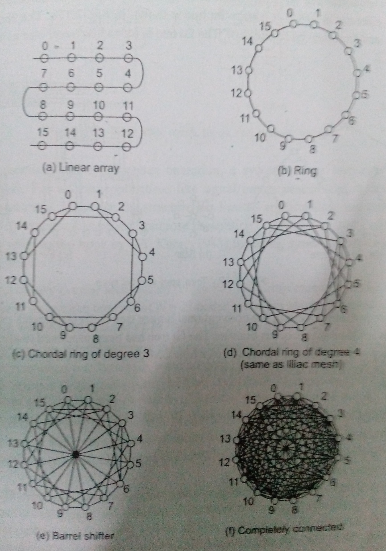

Slide 114
Static Networks – Tree and Star
A k-level completely balanced binary tree will have N = 2^{k} – 1 nodes, with maximum node degree of 3 and network diameter is 2(k – 1).
The balanced binary tree is scalable, since it has a constant maximum node degree.
A star is a two-level tree with a node degree d = N – 1 and a constant diameter of 2.

Slide 115
Static Networks – Fat Tree
A fat tree is a tree in which the number of edges between nodes increases closer to the root (similar to the way the thickness of limbs increases in a real tree as we get closer to the root).
The edges represent communication channels (“wires”), and since communication traffic increases as the root is approached, it seems logical to increase the number of channels there.

Slide 116
Static Networks – Mesh and Torus
Pure mesh – N = n ^{k} nodes with links between each adjacent pair of nodes in a row or column (or higher degree). This is not a symmetric network; interior node degree d = 2k, diameter = k (n – 1).
Illiac mesh (used in Illiac IV computer) – wraparound is allowed, thus reducing the network diameter to about half that of the equivalent pure mesh.
A torus has ring connections in each dimension, and is symmetric. An n × n binary torus has node degree of 4 and a diameter of 2 × ⎣n / 2⎦ .

Slide 117
Static Networks – Systolic Array
A systolic array is an arrangement of processing elements and communication links designed specifically to match the computation and communication requirements of a specific algorithm (or class of algorithms).
This specialized character may yield better performance than more generalized structures, but also makes them more expensive, and more difficult to program.

Slide 118
Network Throughput
Network throughput – number of messages a network can handle in a unit time interval.
One way to estimate is to calculate the maximum number of messages that can be present in a network at any instant (its capacity); throughput usually is some fraction of its capacity.
A hot spot is a pair of nodes that accounts for a disproportionately large portion of the total network traffic (possibly causing congestion).
Hot spot throughput is maximum rate at which messages can be sent between two specific nodes.

Slide 119
Dynamic Connection Networks
Dynamic connection networks can implement all communication patterns based on program demands.
In increasing order of cost and performance, these include
  bus systems
  multistage interconnection networks
  crossbar switch networks
Price can be attributed to the cost of wires, switches, arbiters, and connectors.
Performance is indicated by network bandwidth, data transfer rate, network latency, and communication patterns supported.

Slide 120
Dynamic Networks – Bus Systems
A bus system (contention bus, time-sharing bus) has
  a collection of wires and connectors
  multiple modules (processors, memories, peripherals, etc.) which connect to the wires
  data transactions between pairs of modules
Bus supports only one transaction at a time.
Bus arbitration logic must deal with conflicting requests.
Lowest cost and bandwidth of all dynamic schemes.
Many bus standards are available.

Slide 121
Dynamic Networks – Switch Modules
An a × b switch module has a inputs and b outputs. A binary switch has a = b = 2.
It is not necessary for a = b, but usually a = b = 2^{k}, for some integer k.
In general, any input can be connected to one or more of the outputs. However, multiple inputs may not be connected to the same output.
When only one-to-one mappings are allowed, the switch is called a crossbar switch.

Slide 122
Multistage Networks
In general, any multistage network is comprised of a collection of a × b switch modules and fixed network modules. The a × b switch modules are used to provide variable permutation or other reordering of the inputs, which are then further reordered by the fixed network modules.
A generic multistage network consists of a sequence alternating dynamic switches (with relatively small values for a and b) with static networks (with larger numbers of inputs and outputs). The static networks are used to implement interstage connections (ISC).

Slide 123
Omega Network
A 2 × 2 switch can be configured for
  Straight-through
  Crossover
  Upper broadcast (upper input to both outputs)
  Lower broadcast (lower input to both outputs)
  (No output is a somewhat vacuous possibility as well)
With four stages of eight 2 × 2 switches, and a static perfect shuffle for each of the four ISCs, a 16 by 16 Omega network can be constructed (but not all permutations are possible).
In general , an n-input Omega network requires log ₂ n stages of 2 × 2 switches and n / 2 switch modules.

Slide 124
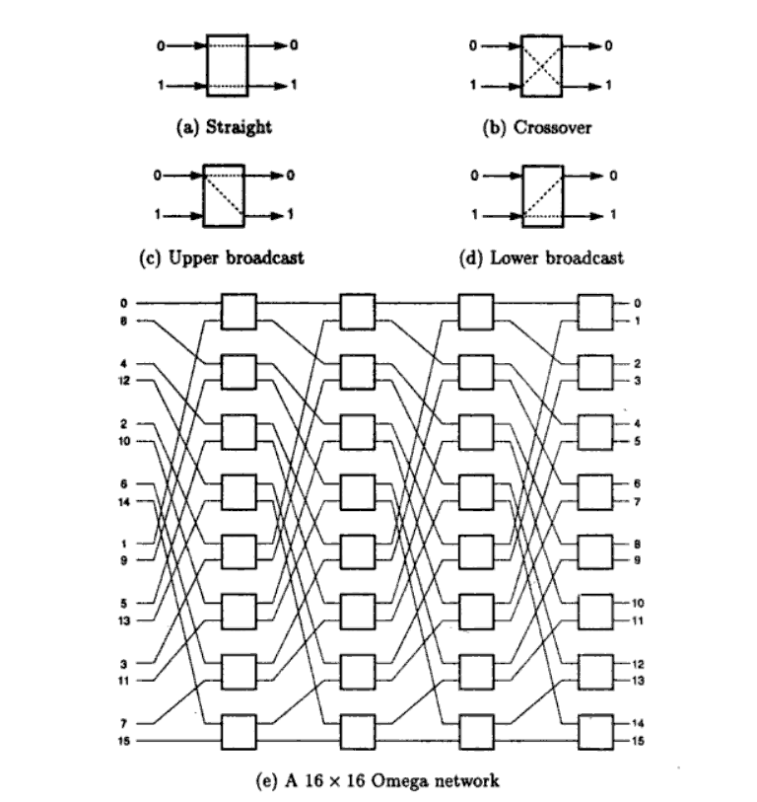

Slide 125
Baseline Network
A baseline network can be shown to be topologically equivalent to other networks (including Omega), and has a simple recursive generation procedure.
Stage k (k = 0, 1, …) is an m × m switch block (where m = N / 2^{k} ) composed entirely of 2 × 2 switch blocks, each having two configurations: straight through and crossover.

Slide 126
4 × 4 Baseline Network

Slide 127
Crossbar Networks
A m × n crossbar network can be used to provide a constant latency connection between devices; it can be thought of as a single stage switch.
Different types of devices can be connected, yielding different constraints on which switches can be enabled.
  With m processors and n memories, one processor may be able to generate requests for multiple memories in sequence; thus several switches might be set in the same row.
  For m × m interprocessor communication, each PE is connected to both an input and an output of the crossbar; only one switch in each row and column can be turned on simultaneously. Additional control processors are used to manage the crossbar itself.

Slide 128
Week 9
Slides 128-145

Slide 129
Pipelining

Slide 130
Overview
Pipelining is widely used in modern processors.
Pipelining improves system performance in terms of throughput.
Pipelined organization requires sophisticated compilation techniques.

Slide 131































Basic Concepts
●
Pipelining is an implementation technique that overlaps multiple instruction execution.
An instruction is broken into smaller steps
Each smaller step (pipeline stage or pipeline segment) takes a fraction of the time needed to complete the entire instruction.
●
●

Slide 132
Making the Execution of Programs Faster
Use faster circuit technology to build the processor and the main memory.
Arrange the hardware so that more than one operation can be performed at the same time.
In the latter way, the number of operations performed per second is increased even though the elapsed time needed to perform any one operation is not changed.

Slide 133
Traditional Pipeline Concept
●Laundry Example
●Ann, Brian, Cathy, Dave
each have one load of clothes to wash, dry, and fold
●Washer takes 30 minutes
A B C D
●Dryer takes 40 minutes
●“Folder” takes 20 minutes

Slide 134
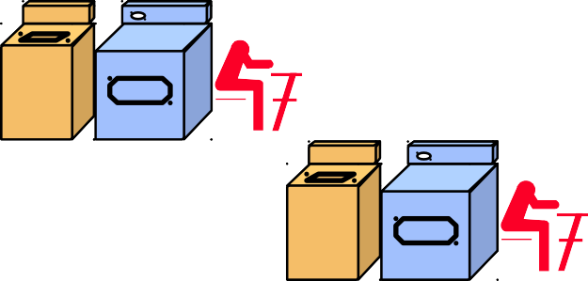
Traditional Pipeline Concept
6 PM
7
8
9
10
11
Midnight
Time
30 40 20 30 40 20 30 40 20 30 40 20
Sequential laundry takes 6 hours for 4 loads
If they learned pipelining, how long would laundry take?
A
B
C D

Slide 135
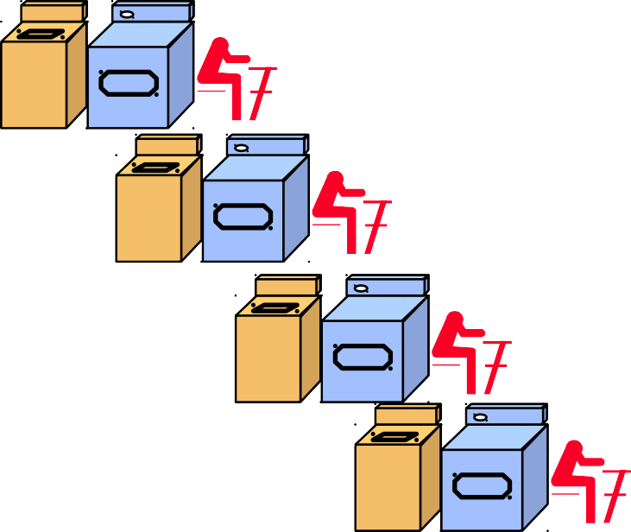
Traditional Pipeline Concept
6 PM
7
8
9
10
11
Midnight
T
a s k
Time
30 40 40 40 40 20
A
Pipelined laundry takes
3.5 hours for 4 loads
O
r d e r
B
C
D

Slide 136
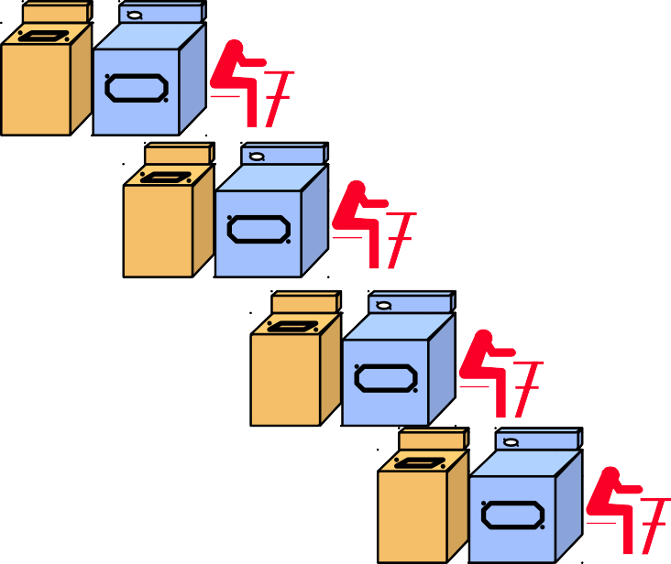
Traditional Pipeline Concept
6 PM 7 8 9
Pipelining doesn’t help latency of single task, it helps
throughput of entire workload
Pipeline rate limited by slowest pipeline stage
Multiple tasks operating simultaneously using different resources
Potential speedup = Number pipe stages
Unbalanced lengths of pipe stages reduces speedup
Time to “fill” pipeline and time to “drain” it reduces speedup
Stall for Dependences
Time
T
a s k
30 40 40 40 40 20
A
O
r
d e r
B
C
D

Slide 137
Use the Idea of Pipelining in a Computer
Fetch + Execution
Time
I₁
I₂
I₃
Time
Clock cycle
1
2
3
4
F₁ | E 1 | F₂ | E 2 | F₃ | E 3
Instruction
I₁
F₁
E₁
(a) Sequential execution
I₂
F₂
E₂
Interstage buffer B1
I₃
F₃
E₃
Instruction fetch unit
Execution unit
(c) Pipelined execution
(b) Hardware organization
Figure 8.1. Basic idea of instruction pipelining.

Slide 138
Use the Idea of Pipelining in a Computer
Clock cycle | 1 | 2 | 3 | 4 | 5 | 6 | Time 7
Instruction
I₁ | F₁ | D₁ | E₁ | W₁
I₂ |  | F₂ | D₂ | E₂ | W₂
I₃ |  |  | F₃ | D₃ | E₃ | W₃
I₄ |  |  |  | F₄ | D₄ | E₄ | W₄
Fetch + Decode
+ Execution + Write
(a) Instruction execution divided into four steps
Interstage buffers
F : Fetch instruction
D : Decode instruction and fetch operands
E: Execute operation
W : Write results
B1
B2
B3
(b) Hardware organization
Figure 8.2. A 4­ stage pipeline.

Slide 139
Role of Cache Memory
Each pipeline stage is expected to complete in one clock cycle.
The clock period should be long enough to let the slowest pipeline stage to complete.
Faster stages can only wait for the slowest one to complete.
Since main memory is very slow compared to the execution, if each instruction needs to be fetched from main memory, pipeline is almost useless.
Fortunately, we have cache.

Slide 140
Pipeline Performance
The potential increase in performance resulting from pipelining is proportional to the number of pipeline stages.
However, this increase would be achieved only if all pipeline stages require the same time to complete, and there is no interruption throughout program execution.
Unfortunately, this is not true.

Slide 141
Pipeline Performance
Clock cycle | 1 | 2 | 3 | 4 | 5 | 6 | 7 | 8 | Time 9
Instruction
I₁ | F₁ | D₁ | E₁ | W₁
I₂ |  | F₂ | D₂ |  | E₂ |  | W₂
I₃ |  |  | F₃ | D₃ |  |  | E₃ | W₃
I₄ |  |  |  | F₄
I₅
D₄ | E₄ | W₄
F₅ | D₅ | E₅
Figure 8.3.
Effect of an execution operation taking more than one clock cycle.

Slide 142
Pipeline Performance
●
The previous pipeline is said to have been stalled for two clock cycles.
Any condition that causes a pipeline to stall is called a hazard.
Data hazard – any condition in which either the source or the destination operands of an instruction are not available at the time expected in the pipeline. So some operation has to be delayed, and the pipeline stalls.
Instruction (control) hazard – a delay in the availability of an instruction causes the pipeline to stall.
Structural hazard – the situation when two instructions require the use of a given hardware resource at the same time.
●
●
●
●

Slide 143
Pipeline Performance
Time
Instruction hazard
Clock cycle 1 2 3 4 5 6 7
Instruction
8
9
I₁
F₁ | D₁ | E₁ | W₁
I₂
I₃
F₂ | D₂ | E₂ | W₂
F₃ | D₃ | E₃ | W₃
(a) Instruction execution steps in successive clock cycles
Time
Clock cycle 1
2
3
4
5
6
7
8
9
Stage
F: Fetch | F₁ | F₂ | F₂ | F₂ | F₂ | F₃
D: Decode |  | D₁ | idle | idle | idle | D₂ | D₃
E: Execute |  |  | E₁ | idle | idle | idle | E₂ | E₃
W: Write |  |  |  | W₁ | idle | idle | idle | W₂ | W₃
Idle periods – stalls (bubbles)
(b) Function performed by each processor stage in successive clock cycles
Figure 8.4. Pipeline stall caused by a cache miss in F2.

Slide 144
Pipeline Performance
_{Structural} Load X(R1), R2
hazard
Time
Clock cycle 1
Instruction
2
3
4
5
6
7
I₁
I₂ (Load) I₃
I₄
F₁ | D₁ | E₁ | W₁
F₂ | D₂ | E₂ | M₂ | W₂
F₃ | D₃ | E₃ |  | W₃
F₄ | D₄ |  | E₄
I₅
F₅
D₅
Figure 8.5.
Effect of a Load instruction on pipeline timing.

Slide 145
Pipeline Performance
Again, pipelining does not result in individual instructions being executed faster; rather, it is the throughput that increases.
Throughput is measured by the rate at which instruction execution is completed.
Pipeline stall causes degradation in pipeline performance.
We need to identify all hazards that may cause the pipeline to stall and to find ways to minimize their impact.

Slide 146
Week 10
Slides 146-153

Slide 147
Data Hazards

Slide 148
Data Hazards
●
We must ensure that the results obtained when instructions are executed in a pipelined processor are identical to those obtained when the same instructions are executed sequentially.
Hazard occurs
A ← 3 + A
B ← 4 × A
No hazard
A ← 5 × C
B ← 20 + C
When two operations depend on each other, they must be executed sequentially in the correct order.
Another example: Mul R2, R3, R4 Add R5, R4, R6
●
●
●
●

Slide 149
Data Hazards
Clock cycle | 1 |  | 2 |  | 3 | 4 |  | 5 | 6 | 7 | 8 | Time 9
Instruction
I₁ (Mul) | F₁ |  | D₁ |  | E₁ | W₁
I₂ (Add) |  |  | F₂ |  | D₂
I₃ |  |  |  |  | F₃
I₄
^{D}2A | E₂ | W₂
D₃ | E₃ | W₃
F₄ | D₄ | E₄ | W₄
Figure 8.6. Pipeline stalled by data dependency between D₂ and W₁.
Figure 8.6. Pipeline stalled by data dependency between D₂ and W₁.

Slide 150
Operand Forwarding
Instead of from the register file, the second instruction can get data directly from the output of ALU after the previous instruction is completed.
A special arrangement needs to be made to “forward” the output of ALU to the input of ALU.

Slide 151
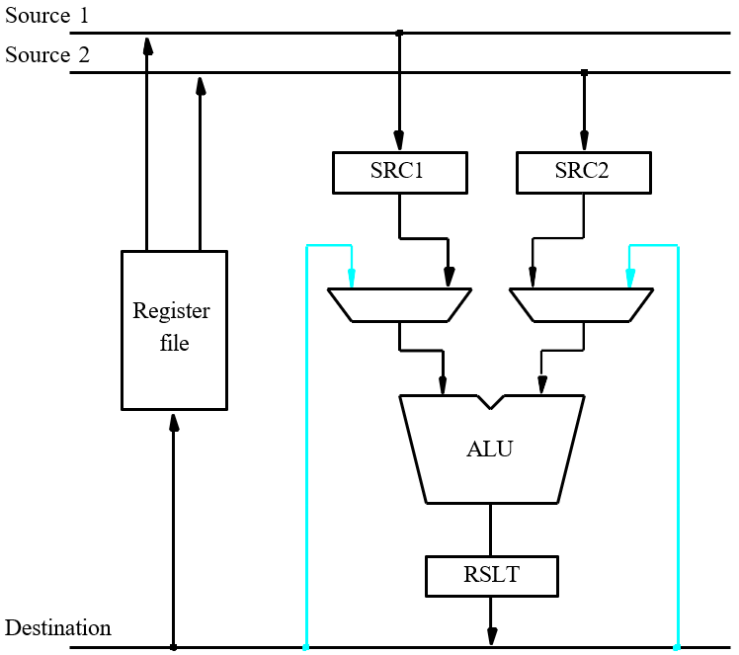
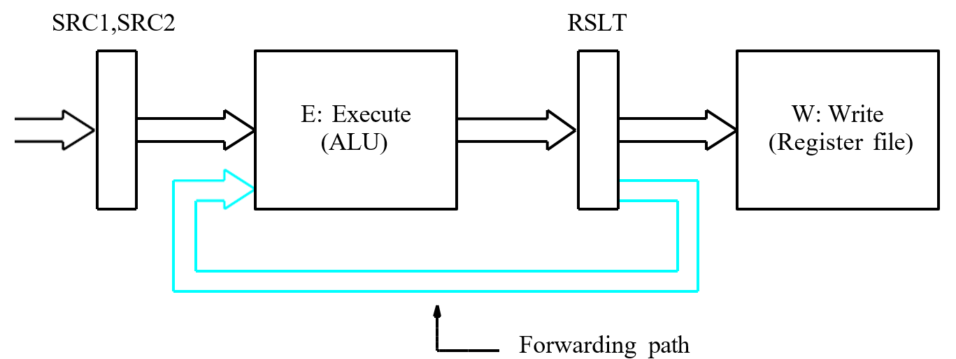
(a) Datapath
(b) Position of the source and result registers in the processor pipeline
Figure 8.7. Operand forw arding in a pipelined processor.

Slide 152
Handling Data Hazards in Software
Let the compiler detect and handle the hazard:
I1: Mul R2, R3, R4 NOP
NOP
I2: Add R5, R4, R6
The compiler can reorder the instructions to perform some useful work during the NOP slots.

Slide 153
Side Effects
●
●
The previous example is explicit and easily detected.
Sometimes an instruction changes the contents of a register other than the one named as the destination.
When a location other than one explicitly named in an instruction as a destination operand is affected, the instruction is said to have a side effect. (Example?)
Example: conditional code flags:
Add R1, R3
AddWithCarry R2, R4
Instructions designed for execution on pipelined hardware should have few side effects.
●
●
●

Slide 154
Week 11
Slides 154-163

Slide 155
Instruction Hazards

Slide 156
Overview
Whenever the stream of instructions supplied by the instruction fetch unit is interrupted, the pipeline stalls.
Cache miss
Branch

Slide 157
Unconditional Branches
Time
Clock cycle
1
2
3
4
5
6
Instruction
I₁
F₁
E₁
I₂ (Branch)
F₂
E₂
Execution unit idl
I₃
F₃
X
I_{k}
F_{k}
E_{k}
^{I}k+1
^{F}k+1
^{E}k+1
Figure 8.8.
An idle cycle caused by a branch instruction.

Slide 158
Branch Timing
Clock cycle | 1 | 2 | 3 | 4 | 5 | 6 | 7 | Time 8
I₁ | F₁ | D₁ | E₁ | W₁
I₂ (Branch) |  | F₂ | D₂ | E₂
I₃ |  |  | F₃ | D₃ | X
I₄ |  |  |  | F₄ | X
I_{k} |  |  |  |  | F_{k} | D_{k} | E_{k} | W_{k}
^{I}k+1 |  |  |  |  |  | ^{F}k+1 | ^{D}k+1 | ^{E}k+1
Branch penalty
Reducing the penalty
(a) Branch address computed in Execute stage
Time
Clock cycle
1
2
3
4
5
6
7
I₁
F₁ | D₁ | E₁ | W₁
I₂ (Branch)
F₂
D₂
I₃
F₃
X
F_{k} | D_{k} | E_{k} | W_{k}
I_{k}
^{I}k+1
(b) Branch address computed in Decode stage
^{F}k+1 | ^{D}k+1 | ^{E}k+1
Figure 8.9. Branch timing.

Slide 159
Instruction Queue and Prefetching
Instruction fetch unit
Instruction queue
F : Fetch instruction
D : Dispatch/ Decode unit
E : Execute instruction
W : Write results
Figure 8.10. Use of an instruction queue in the hardware organization of Figure 8.2b.

Slide 160
Superscalar Operation

Slide 161
Overview
The maximum throughput of a pipelined processor is one instruction per clock cycle.
If we equip the processor with multiple processing units to handle several instructions in parallel in each processing stage, several instructions start execution in the same clock cycle – multiple-issue.
Processors are capable of achieving an instruction execution throughput of more than one instruction per cycle – superscalar processors.
Multiple-issue requires a wider path to the cache and multiple execution units.

Slide 162
Superscalar
F : Instruction fetch unit
Instruction queue
Floating­ point unit
Dispatch unit
W : Write results
Integer unit
Figure 8.19.
A processor with two execution units.

Slide 163
SIX STAGE OF INSTRUCTION PIPELINING
Fetch Instruction(FI)
Read the next expected instruction into a buffer
Decode Instruction(DI)
Determine the opcode and the operand specifiers.
Calculate Operands(CO)
Calculate the effective address of each source operand.
Fetch Operands(FO)
Fetch each operand from memory. Operands in registers need not be fetched.
Execute Instruction(EI)
Perform the indicated operation and store the result
Write Operand(WO)
Store the result in memory.

Slide 164
Week 12
Slides 164-173

Slide 165
Parallel Programming Models

Slide 166
Introduction
collection of program abstractions providing a simplified and transparent view of the computer hardware/software system to the programmer
designed for multiprocessors, multicomputer or vector/SIMD computers
Five models:
⎫ Shared-Variable Model
⎫ Message-Passing Model
⎫ Data-Parallel Model
⎫ Object-oriented Model
⎫ Functional and Logic Models

Slide 167
Shared-Variable Model
⎫
To limit the scope and rights, the process address space may be shared or restricted.
Mechanisms for IPC:
1. IPC using shared variable:
Process B
Process
A
Shared Variables in a common memory
Process C
2. IPC using message passing:
Process D
Process E

Slide 168
Following are some issues of Shared-variable Model:
Shared-Variable communication:
Critical Section(CS):
code segment accessing shared variables.
Requirements are –
Mutual exclusion
No deadlock in waiting
Non preemption
Eventual entry
Protected Access: based on CS value
Multiprogramming
Multiprocessing – two types:
MIMD mode
MPMD mode
Multitasking
Multithreading

Slide 169
Partitioning and Replication:
  Program partitioning is a technique for decomposing a large program and data set into many small pieces for parallel execution by multiple processors.
Program replication is referred to duplication of the same program code for parallel execution on multiple processor over different data sets.
Scheduling and Synchronization:
♣
Scheduling of divided program modules on parallel processor
Two types are :
  Static scheduling
  Dynamic scheduling
♣
Cache Coherence and Protection:
If the value is returned on a read instruction is always the value written by the latest write instruction on the same memory location is called coherent.

Slide 170
Message-Passing Model
Synchronous Message Passing –
It is must synchronize the sender process andthe receiver process in time and space
Asynchronous Message Passing –
It does not require message sending and receiving be synchronized in time and space
N o n blocking can be achieved
Distributing the computations:
Subprogram level is handled rather than at the instructional or fine grain process level in a tightly coupled multiprocessor

Slide 171
Data-Parallel Model
I t is easier to write and to debug because parallelism is explicitly handled by hardware synchronization and flow control.
I t requires the use of pre-distributed data sets
Synchronization is done at compile time rather than run time.
t h e following are some issued handled
Data Parallelism-
Array Language Extensions
Compiler support

Slide 172
Object-Oriented Model
Concurrent OOP – 3 application demands
There is increased use of interacting processes by
individual users
Workstation networks have become a cost-effective mechanism
Multiprocessor technology in several variants has
advanced to the point of providing supercomputing power
An actor model
It is presented as one framework for COOP
They are self-contained , interactive, independent components of a computing system.
Basic primitives are :create to , send to, become
Parallelism in COOP:
3 patterns- 1. pipeline concurrency 2.divide and conquer
currency 3.cooperative problem solving

Slide 173
Functional and Logic Models
Two types of language oriented programming models are
Functional programming model
It emphasizes functionality of a program
No concepts of storage, assignment and branching
All single-assignment and dataflow languages are
functional in nature
Some e.g. are Lisp, SISAL and strand 88
Logic programming model
Based on logic ,logic programming that suitable for dealing with large database.
Some e.g. are
concurrent Prolog - Concurrent Parlog

Slide 174
Week 13
Slides 174-183

Slide 175
DISTRIBUTING PROCESSING
Notes:
Designed by: IMTIAZ HUSSAIN
175

Slide 176
OUTLINE
Distributed Processing
Distributed System
Architecture
Form of D.P
Techniques
Challenges
Advantage/Disadvantage

Slide 177

What is Distributed Processing
Distributed Processing is a technique of distributing the information over a number of devices.
The devices may be computers or data terminals with some level of intelligence.
The devices are interconnected with communication facilities.

Slide 178
What is Distributed System
A distributed system is one in which components located at networked computers communicate and coordinate their actions only by passing messages.
Examples
  The internet
  An intranet which is a portion of the internet managed by an organization

Slide 179
Architecture
Software layers
System architectures
Interfaces and objects
Design requirements for distributed architectures

Slide 180
Software layers
Applications, services
Middleware
Operating system
Computer and network hardware

Slide 181
System architectures
Client-server model
Services provided by multiple servers
Proxy srvers and caches
Peer processes

Slide 182
Design requirements for distributed architectures
Performance issues
Use of caching and replication
Dependability issues

Slide 183
Design requirements for distributed architectures
Performance issues
  Responsiveness
  Balancing computer loads
  Quality of services
Caching and replication
  The performance issues often appear to be major obstacles to the successful deployment of DS, but much progress has been made in the design of systems that overcome them by the use of data replication and caching.
Dependability issues
  Correctness
  Security
  Fault tolerance

Slide 184
Week 14
Slides 184-200

Slide 185
Form of Distributed Processing
Distributed Applications
Distributed Devices
Network Management and Control
Distributed Data

Slide 186
Distributed Applications
One application splits up into components that are dispersed among a number of machines
One application replicated on a number of machines
A number of different applications distributed among a number of machines
Can be characterized by vertical or horizontal partitioning

Slide 187
Distributed Devices
Support a distributed set of devices that can be controlled by processors, e.g. ATMs or laboratory interface equipments
Distribution of processing technology to various locations of the manufacturing process in factory automation

Slide 188
Techniques of Distributed Processing
Centralized
Decentralized
Parallel
Open Distributed Processing
Clustering

Slide 189
Centralized
Centralized Processing is done at a central location, using terminals that are attached to a central computer
The central computer performs the computing functions and controls the remote terminals. This type of system relies totally on the central computer.

Slide 190
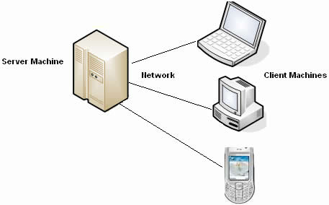
Centralized
Example: Client/server is the most common example of centralized processing, where server is controlling all the activities on the network.

Slide 191
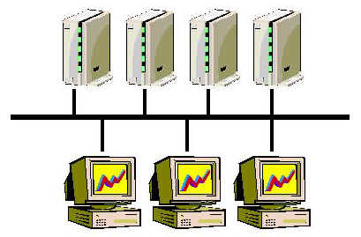
Decentralized
Computer systems in different locations. Although data may be transmitted between the computers periodically
Example: Yahoo server is the example of the decartelized processing. On each login it connects you to a different server .

Slide 192
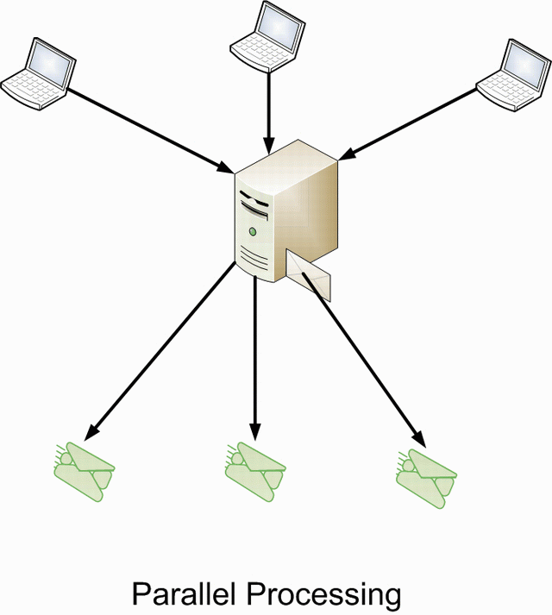
Parallel Processing
Parallel processing is the simultaneous processing of the same task on two or more microprocessors in order to obtain faster results
Multiple processor
Multiple computer
Shared memory resources

Slide 193
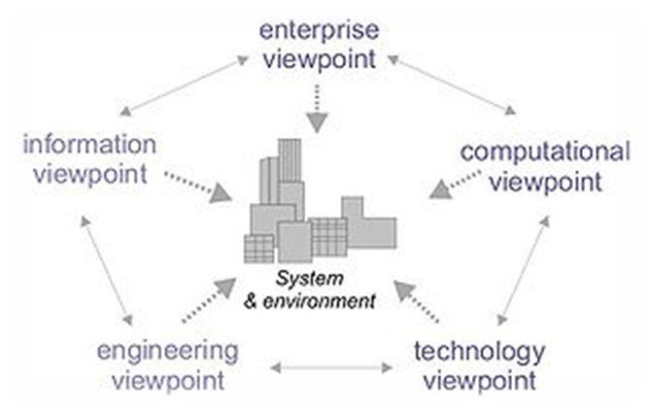
Open Distributed Processing
ODP is a reference model in computer science, which provides a coordinating framework for the standardization of open distributed processing (ODP).
It supports distribution, interworking, platform and technology independence, and portability, together with an enterprise architecture framework for the specification of ODP systems.

Slide 194
Clustering
A cluster is a group of individual computer systems that can be made to appear as one computer system.
Clustering is just one form of parallel computing.
key points that distinguishes clustering from other is the ability to view the cluster as either a single entity or a collection of stand-alone systems
For example: a cluster of web servers can appear as one large web server, but at the same time, individual systems within the cluster can be accessed as individual systems,

Slide 195
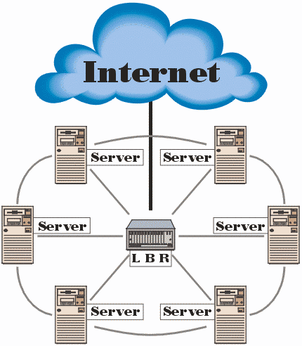
Clustering
Example:
  Internet is an example of clustering, where different server are working but they look like a single server.
Notes:
195

Slide 196
Challenges
Heterogeneity
Security
Scalability
Failure handling
Concurrency

Slide 197
Advantages
Quicker response time
  By locating processing power close to user, response time is typically improved. This means that the system responds rapidly to commands entered by users.
Lower costs
  Long-distance communication costs are declining at a slower rate than the cost of computer power
  Distributed processing can reduce the volume of data that must be transmitted over long-distances and thereby reduce long-distance costs.
Improved data integrity
  High degrees of accuracy and correctness may be achieved by giving users control over data entry and storage.

Slide 198
Advantages
Reduced host processor costs
  The productive life of a costly mainframe can be extended by off-loading some its processing tasks to other, less expensive machines
Resource sharing
  One of the main advantages of developing microcomputer networks is because they make it possible to share expensive resources such as high-speed, color laser printers, fast data storage devices, and high-priced software packages.

Slide 199
Disadvantage
Complexities
  A lot of extra programming is required to set up a distributed system
Network failure
  Since distributed system will be connected through network and in case of network failure non of the systems will work
Security
  The information need to be passed between the network. And it can be tracked and can be used for illegal purpose.
Costly software
Not all situations are suitable for distributed computing

Slide 200


Slide 201
Week 15
Slides 201-217

Slide 202
Distributed Database

Slide 203
Outline
Concept
Distributed Database Types
  Homogeneous
  Heterogeneous
Distributed Database Design
  Data Fragmentation
  Data Allocation
  Data Replication

Slide 204
Concept
A distributed database (DDB) is a collection of multiple, logically interrelated databases distributed over a computer network.
A distributed database management system (D–DBMS) is the software that manages the DDB and provides an access mechanism that makes this distribution transparent to the users.
Distributed database system (DDBS) = DDB + D–DBMS

Slide 205
Concept
Collection of logically-related shared data.
Data split into fragments.
Fragments may be replicated.
Fragments/replicas allocated to sites.
Sites linked by a communications network.
Data at each site is under control of a DBMS.
DBMSs handle local applications autonomously.
Each DBMS participates in at least one global application.

Slide 206
Functionality
Security
Keeping track of data
Replicated data management
System catalog management
Distributed transaction management
Distributed database recovery

Slide 207
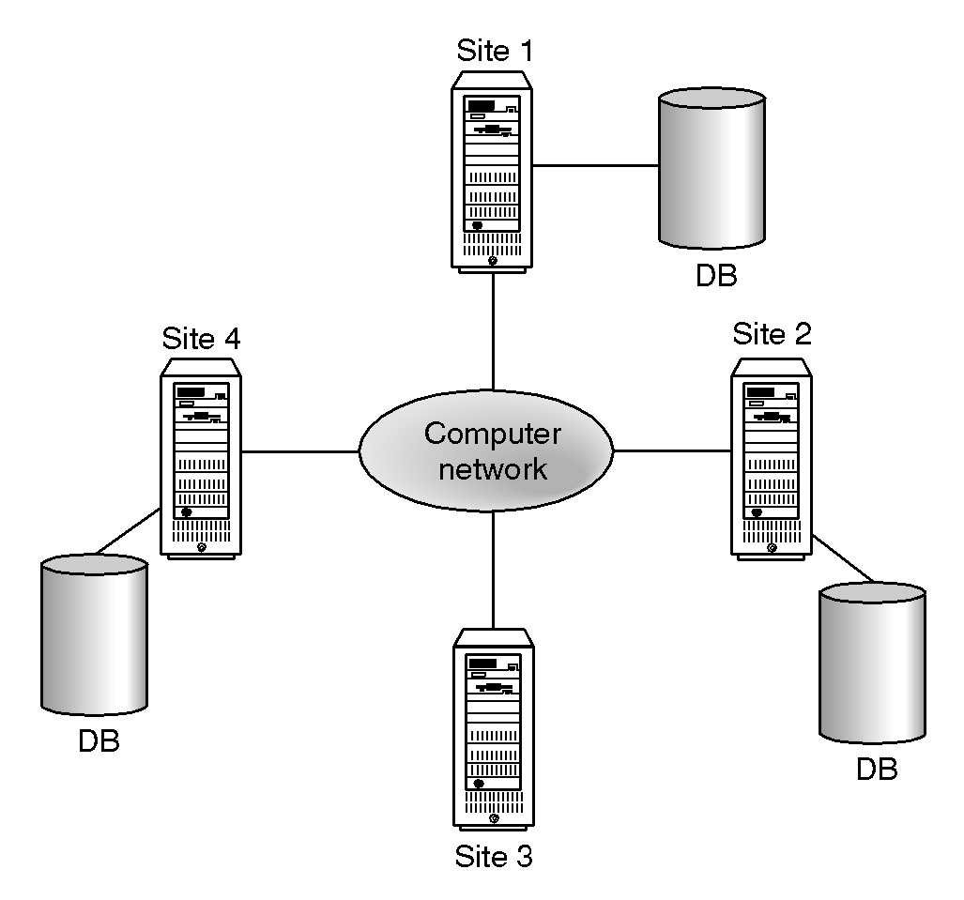
Distributed DBMS

Slide 208
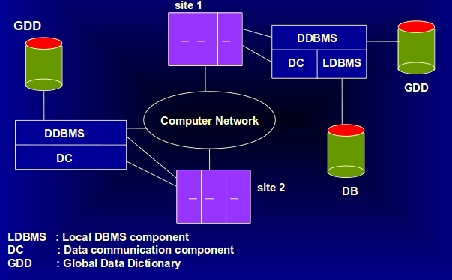
Component Architecture for a D-DBMS

Slide 209
Advantages of D-DBMS
Organizational Structure
Share-ability and Local Autonomy
Improved Availability
Improved Reliability
Improved Performance
Economics
Modular Growth

Slide 210
Disadvantages of D-DBMS
Complexity
Cost
Security
Integrity Control More Difficult
Lack of Standards
Lack of Experience
Database Design More Complex

Slide 211
Types of D-DBMS
Homogeneous D-DBMS
Heterogeneous D-DBMS

Slide 212
Homogeneous D-DBMS
All sites have identical software and are aware of each other and agree to cooperate in processing user requests.
Much easier to design and manage
The operating system used, at each location must be same or compatible.
The database application (or DBMS) used at each location must be same or compatible.
It appears to user as a single system
All access is through one, global schema
The global schema is the union of all the local schema

Slide 213
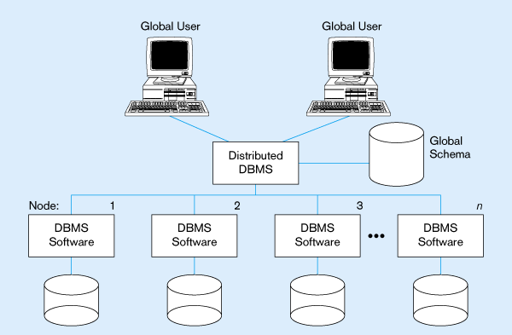
Homogeneous Database

Slide 214
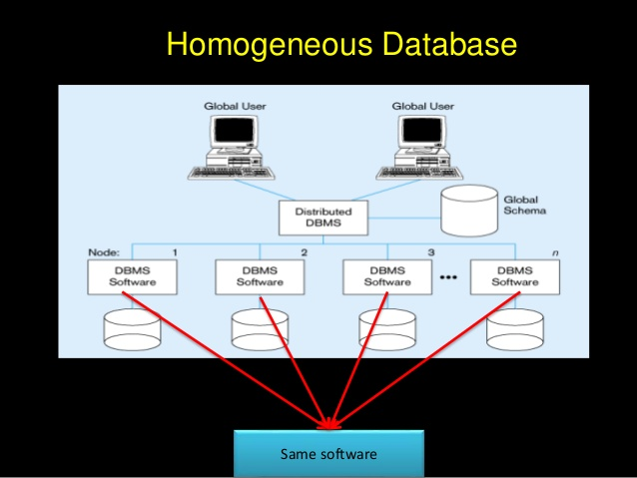

Slide 215
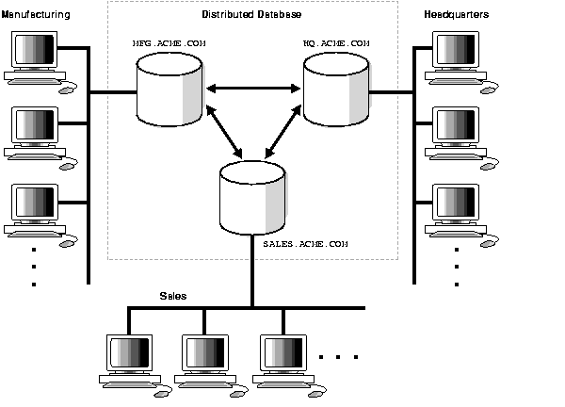
Homogeneous Distributed Database Example
A distributed system connects three databases: hq, mfg, and sales
An application can simultaneously access or modify the data in several databases in a single distributed environment.

Slide 216
Heterogeneous D-DBMS
Different sites may use different schema and software.
Different nodes may have different hardware & software and data structures at various nodes or locations are also incompatible.
Different computers and operating systems, database applications or data models may be used at each of the locations.
Difficult to manage and design.
Local access is done using the local DBMS and schema
Remote access is done using the global schema

Slide 217
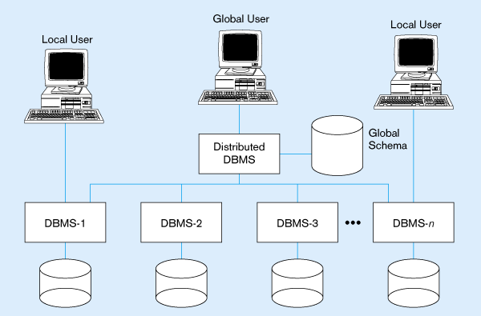
Typical Heterogeneous Environment

Slide 218
Week 16
Slides 218-235

Slide 219
Distributed Database Design
Three key issues:
  Data Fragmentation
    Relation may be divided into a number of sub relations, which are then distributed.
    Breaking up the database into logical units called fragments and assigned for storage at various sites.
  Data Allocation
    The process of assigning a particular fragment to a particular site in a distributed system.
  Data Replication
    Copy of fragment may be maintained at several sites.

Slide 220
Distributed Database Design
Data Fragmentation
  data can be distributed by storing individual tables at different sites
  data can also be distributed by decomposing a table and storing portions at different sites – called Fragmentation
  fragmentation can be horizontal or vertical

Slide 221
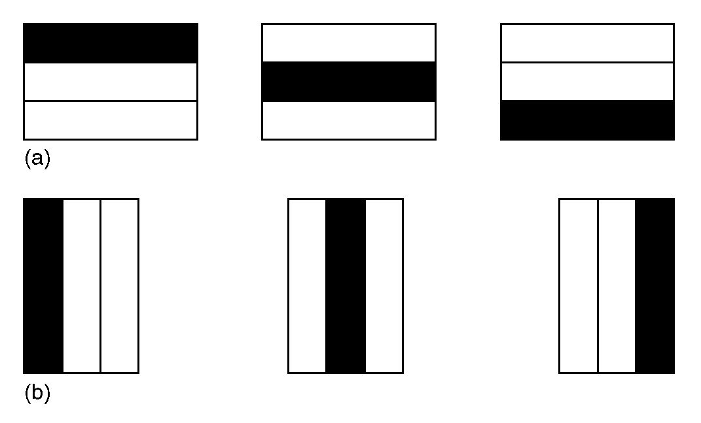
Horizontal and Vertical Fragmentation

Slide 222
Why use Fragmentation?
Usage - in general applications use views so it’s appropriate to work with subsets
Efficiency - data stored close to where it is most frequently used
Parallelism - a transaction can divided into several sub-queries to increase degree of concurrency
Security - data more secure - only stored where it is needed
Disadvantages:
Performance - may be slower
Integrity - more difficult

Slide 223
Distributed Database Design
Horizontal Fragmentation
  Each fragment, T_{i} , of table T contains a subset of the rows
  Each tuple of T is assigned to one or more fragments
  Horizontal fragmentation is lossless
  A selection condition may be composed of several conditions connected by AND or OR
  Derived horizontal fragmentation: It is the partitioning of a primary relation to other secondary relations which are related with Foreign keys

Slide 224

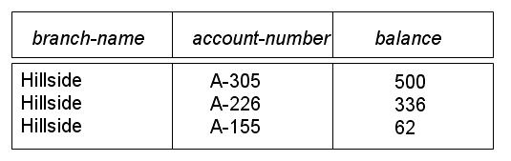
Horizontal Fragmentation Example
A bank account schema has a relation
Account-schema = (branch-name, account-number, balance).
It fragments the relation by location and stores each fragment locally: rows with branch-name = `Hillside` are stored in the Hillside in a fragment

Slide 225

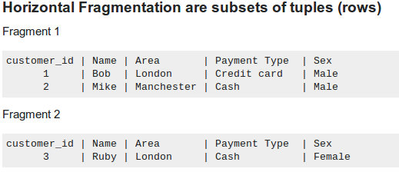
Horizontal Fragmentation Example

Slide 226
Distributed Database Design
Vertical Fragmentation
  It is a subset of a relation which is created by a subset of columns. Thus a vertical fragment of a relation will contain values of selected columns. There is no selection condition used in vertical fragmentation.
  Consider the customer relation. A vertical fragment can be created by keeping the values of Name, Area, Sex.
  Because there is no condition for creating a vertical fragment, each fragment must include the primary key attribute of the parent relation customer. In this way all vertical fragments of a relation are connected.

Slide 227
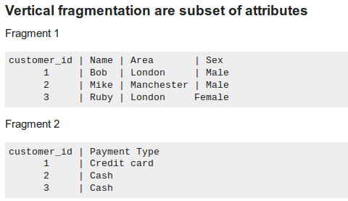
Vertical Fragmentation Example

Slide 228
Distributed Database Design
Data Allocation
  Four alternative strategies regarding placement of data
    Centralized
    Partitioned (or Fragmented)
    Complete Replication
    Selective Replication

Slide 229
Data Allocation
Centralized
  Consists of single database and DBMS stored at one site with users distributed across the network.
Partitioned
  Database partitioned into disjoint fragments, each fragment assigned to one site.
Complete Replication
  Consists of maintaining complete copy of database at each site.
Selective Replication
  Combination of partitioning, replication, and centralization.

Slide 230
Distributed Database Design
Data Replication
  System maintains multiple copies of data, stored in different sites, for faster retrieval and fault tolerance.

Slide 231
Issues of Replication
Data timeliness – high tolerance for out-of-date data may be required
DBMS capabilities – if DBMS cannot support multi-node queries, replication may be necessary
Performance implications – refreshing may cause performance problems for busy nodes
Network heterogeneity – complicates replication
Network communication capabilities – complete refreshes place heavy demand on telecommunications

Slide 232
Advantages of Replication
Availability: failure of site containing relation r does not result in unavailability of r is replicas exist.
Parallelism: queries on r may be processed by several nodes in parallel.
Reduced data transfer: relation r is available locally at each site containing a replica of r.

Slide 233
Disadvantages of Replication
Increased cost of updates: each replica of relation r must be updated.
Increased complexity of concurrency control: concurrent updates to distinct replicas may lead to inconsistent data unless special concurrency control mechanisms are implemented.
One solution: choose one copy as primary copy and apply concurrency control operations on primary copy.

Slide 234


Slide 235


Slide 236
Week 17
Slides 236-263

Slide 237
Parallel Computing and
Programming Environments
MapReduce
Hadoop
Amazon Web Services
Notes:
237

Slide 238
What is MapReduce?
Simple data-parallel programming model
For large-scale data processing
  Exploits large set of commodity computers
  Executes process in distributed manner
  Offers high availability
Pioneered by Google
  Processes 20 petabytes of data per day
Popularized by open-source Hadoop project
  Used at Yahoo!, Facebook, Amazon, …

Slide 239
What is MapReduce used for?
At Google:
  Index construction for Google Search
  Article clustering for Google News
  Statistical machine translation
At Yahoo!:
  “Web map” powering Yahoo! Search
  Spam detection for Yahoo! Mail
At Facebook:
  Data mining
  Ad optimization
  Spam detection

Slide 240
What is MapReduce used for?
Many tasks composed of processing lots of data to produce lots of other data
MapReduce provides
  User-defined functions
  Automatic parallelization and distribution
  Fault-tolerance
  I/O scheduling
  Status and monitoring
In research:
  Astronomical image analysis (Washington)
  Bioinformatics (Maryland)
  Analyzing Wikipedia conflicts (PARC)
  Natural language processing (CMU)
  Particle physics (Nebraska)
  Ocean climate simulation (Washington)

Slide 241
Distributed Grep
Split data
grep
matches
Split data
grep
matches
Very
big
data
All
matches
Split data
grep
matches
cat
Split data
grep
matches
grep is a command-line utility for searching plain-text data sets for lines matching a regular expression.
cat is a standard Unix utility that concatenates and lists files

Slide 242
Map+Reduce
R
E
D
U
C
E
Very
big
data
M
A
P
Partitioning
Function
Result
Map:
  Accepts input key/value pair
  Emits intermediate key/value pair
Reduce :
  Accepts intermediate key/value* pair
  Emits output key/value pair

Slide 243
Architecture Overview
Master node
user
Job tracker
Slave node 1
Slave node 2
Slave node N
Task tracker
Task tracker
Task tracker
Workers
Workers
Workers

Slide 244
Functions in the Model
Map
  Process a key/value pair to generate intermediate key/value pairs
Reduce
  Merge all intermediate values associated with the same key
Partition
  By default : hash(key) mod R
  Well balanced

Slide 245
Programming Concept
Map
  Perform a function on individual values in a data set to create a new list of values
  Example: square x = x * x
  map square [1,2,3,4,5]
  returns [1,4,9,16,25]
Reduce
  Combine values in a data set to create a new value
  Example: sum = (each elem in arr, total +=)
  reduce [1,2,3,4,5]
  returns 15 (the sum of the elements)‏

Slide 246
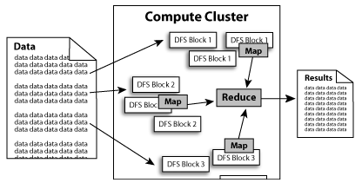
Programming Structure

Slide 247

A Word Counting Example on <Key, Count> Distribution

Slide 248
MapReduce : Operation Steps
When the user program calls the MapReduce function, the following sequence of actions occurs :
1) The MapReduce library in the user program first splits the input files into M pieces – 16 megabytes to 64 megabytes (MB) per piece. It then starts up many copies of program on a cluster of machines.
One of the copies of program is master. The rest are workers that are assigned work by the master.
A worker who is assigned a map task :
  reads the contents of the corresponding input split
  parses key/value pairs out of the input data and passes each pair to the user - defined Map function.
The intermediate key/value pairs produced by the Map function are buffered in memory.

Slide 249
MapReduce : Operation Steps
4) The buffered pairs are written to local disk, partitioned into R regions by the partitioning function.
The location of these buffered pairs on the local disk are passed back to the master, who forwards these locations to the reduce workers.
5) When a reduce worker is notified by the master about these locations, it reads the buffered data from the local disks of the map workers.
When a reduce worker has read all intermediate data, it sorts it by the intermediate keys so that all occurrences of the same key are grouped together.
6) The reduce worker iterates over the sorted intermediate data and for each unique intermediate key, it passes the key and the corresponding set of intermediate values to the user’s Reduce function.
The output of the Reduce function is appended to a final output file.
7) When all map tasks and reduce tasks have been completed, the master wakes up the user program.
At this point, MapReduce call in the user program returns back to the user code.
After successful completion, output of the mapreduce execution is available in the R output files.

Slide 250
Locality Issue
Master scheduling policy
  Asks GFS for locations of replicas of input file blocks
  Map tasks typically split into 64MB (== GFS block size)
  Map tasks scheduled so GFS input block replica are on same machine or same rack
Effect
  Thousands of machines read input at local disk speed
  Without this, rack switches limit read rate

Slide 251
Fault Tolerance
Reactive way
  Worker failure
    Heartbeat, Workers are periodically pinged by master
      NO response = failed worker
    If the processor of a worker fails, the tasks of that worker are reassigned to another worker.
  Master failure
    Master writes periodic checkpoints
    Another master can be started from the last checkpointed state
    If eventually the master dies, the job will be aborted

Slide 252
Fault Tolerance
Proactive way (Redundant Execution)
  The problem of “stragglers” (slow workers)
    Other jobs consuming resources on machine
    Bad disks with soft errors transfer data very slowly
    Weird things: processor caches disabled (!!)
  When computation almost done, reschedule in-progress tasks
  Whenever either the primary or the backup executions finishes, mark it as completed

Slide 253
Fault Tolerance
Input error: bad records
  Map/Reduce functions sometimes fail for particular inputs
  Best solution is to debug & fix, but not always possible
  On segment fault
    Send UDP packet to master from signal handler
    Include sequence number of record being processed
  Skip bad records
    If master sees two failures for same record, next worker is told to skip the record

Slide 254
Hadoop : software platform originally developed by Yahoo enabling users to write and run applications over vast distributed data.
Attractive Features in Hadoop :
Scalable : can easily scale to store and process petabytes of
data in the Web space
Economical : An open-source MapReduce minimizes the
overheads in task spawning and massive data communication.
Efficient: Processing data with high-degree of parallelism
across a large number of commodity nodes
Reliable : Automatically maintains multiple copies of data to
facilitate redeployment of computing tasks on failures

Slide 255

Typical Hadoop Cluster
Aggregation switch
Rack switch
40 nodes/rack, 1000-4000 nodes in cluster
1 Gbps bandwidth within rack, 8 Gbps out of rack
Node specs (Yahoo terasort):
8 x 2GHz cores, 8 GB RAM, 4 disks (= 4 TB?)

Slide 256

Typical Hadoop Cluster
Image from http://wiki.apache.org/hadoop-data/attachments/HadoopPresentations/attachments/aw-apachecon-eu-2009.pdf

Slide 257
Hadoop Components
Distributed file system (HDFS)
  Single namespace for entire cluster
  Replicates data 3x for fault-tolerance
MapReduce framework
  Executes user jobs specified as “map” and “reduce” functions
  Manages work distribution & fault-tolerance

Slide 258

Hadoop Distributed File System
Files split into 128MB blocks
Blocks replicated across several datanodes (usually 3)
Single namenode stores metadata (file names, block locations, etc)
Optimized for large files, sequential reads
Files are append-only
Namenode
File1
1
2
3
4
1
2
1
3
2
1
4
2
4
3
3
4
Datanodes

Slide 259

HDFS and MapReduce Architecture

Slide 260

Higher-level languages over Hadoop: Pig and Hive
Pig :
Started at Yahoo! Research
Runs about 30% of Yahoo!’s jobs
Features:
  Expresses sequences of MapReduce jobs
  Data model: nested “bags” of items
  Provides relational (SQL) operators (JOIN, GROUP BY, etc)
  Easy to plug in Java functions
  Pig Pen development environment for Eclipse

Slide 261

Hive
Developed at Facebook
Used for majority of Facebook jobs
“Relational database” built on Hadoop
  Maintains list of table schemas
  SQL-like query language (HQL)
  Can call Hadoop Streaming scripts from HQL
  Supports table partitioning, clustering, complex
  data types, some optimizations

Slide 262
Amazon Elastic MapReduce
Provides a web-based interface and command-line tools for running Hadoop jobs on Amazon EC2
Data stored in Amazon S3
Monitors job and shuts down machines after use
Small extra charge on top of EC2 pricing
If you want more control over how you Hadoop runs, you can launch a Hadoop cluster on EC2 manually using the scripts in src/contrib/ec2

Slide 263
Conclusions
MapReduce programming model hides the complexity of work distribution and fault tolerance
Principal design philosophies:
  Make it scalable, so you can throw hardware at problems
  Make it cheap, lowering hardware, programming and admin costs
MapReduce is not suitable for all problems, but when it works, it may save you quite a bit of time
Cloud computing makes it straightforward to start using Hadoop (or other parallel software) at scale

